Slide 1

RFIs, RFQs, and RFPs:
Understanding the Difference
U.S. General Services Administration

Slide 2
Today’s Agenda
The power of responding to Requests for Information (RFI)/Sources Sought Notices (SSN)
Differences between Requests for Quotes (RFQ) and Requests for Proposals (RFP)
Tips on creating more effective responses
Common mistakes to avoid
Insights from federal contracting officers

Slide 3
Core Purpose:
RFI/
SSN
Finding the Right Supplier
RFQ
RFP

Slide 4
Definitions
Request for Information (RFI) / Sources Sought Notice (SSN): A market research tool used to obtain price, delivery, capabilities, interest, etc. for planning purposes
Request for Quote (RFQ): A solicitation method used to obtain price, cost, delivery, and related information from suppliers
Request for Proposal (RFP): A solicitation method which communicates the Government’s requirements and requests proposals

Slide 5
Where are we in the Acquisition Process?
Planning
  RFI
  SSN
Solicitation
  RFQ
  RFP
Evaluations
Award
Administration

Slide 6
Key Differences
 | Why | Where
RFI/SSN Request for Information Sources Sought Notice | Solicit industry input: Government’s: Requirement Strategy Industry’s: Capability Interest | FAR subpart 8.4 FAR part 12 FAR parts 13, 15 FAR 16.505 | GSA Schedules Commercial Items Open Market (GSA OASIS, Alliant)
RFP Request for Proposal | Communicate Requirement & Solicit Proposals | FAR part 12 FAR parts 13, 15 FAR 16.505 | Commercial Items Open Market (GSA OASIS, Alliant)
RFQ Request for Quote | Obtain: Price Cost Delivery Related Information | FAR subpart 8.4 FAR part 13 | GSA Schedules Open Market (Below the SAT)

Slide 7
What to Expect
What is in an RFI?
How Should I Respond?
No standard format
Shorter response times
Overview of the Government’s Requirement
Questions for Industry
Follow the format specified in the RFI
Interest – Will you submit an offer?
Business Size & Primary NAICS
Relative Experience
Subcontractor Involvement
Conflicts of Interest

Slide 8
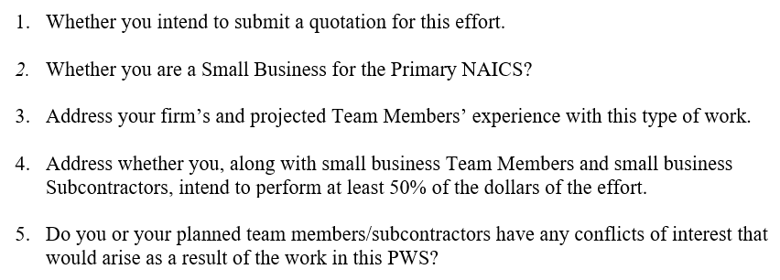
RFI Example - Less Complex

Slide 9
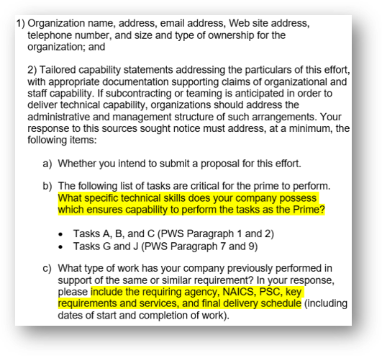
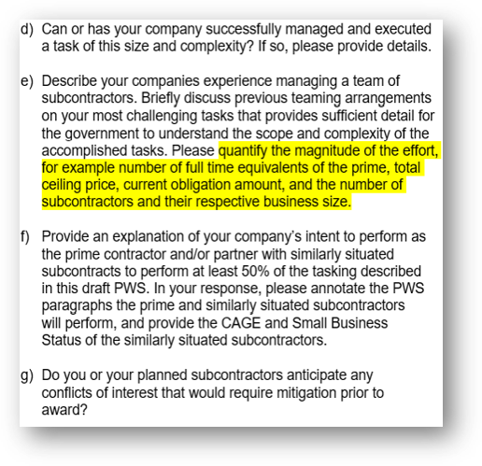
RFI Example - More Complex

Slide 10
RFI Tips
Dos:
Timely
Complete
Focus on the Requirement
Specific-Agencies, Contract Numbers, Figures, Dates, Tasks, Roles, etc.
Don’ts:
Underestimate the importance of your response
Make Assumptions

Slide 11

Question
How does the Government use the information submitted through an RFI response?

Slide 12
RFPs - What to Expect
In accordance with FAR 15.203, at a minimum:
The Government’s Requirement
Terms & Conditions
Instructions (Information required to be in the proposal)
Evaluation Criteria:
  Factors
  Relative importance

Slide 13
RFQs - What to Expect
In accordance with FAR 8.405-2 (c), at a minimum:
Statement of Work (SOW) or Performance Work Statement (PWS)
Evaluation Criteria
Quotes do not establish a binding contract agreement with the Government.
The contract is established when the contractor accepts the Government’s subsequent offer to work by
    Signing the quote, or
    Performance/Delivery

Slide 14
RFQ & RFP Tips
Do:
Read, read, read! (instructions to offerors, PWS/SOW, evaluation criteria)
Ask Questions
Self-evaluate
Be detailed, specific, and responsive (timeliness, no exceptions to the solicitation, ensure all instructions are followed)

Slide 15
RFQ & RFP-Tips
Don’t:
“Low bid”
Grammar mistakes
Restate the requirement
Make assumptions

Slide 16
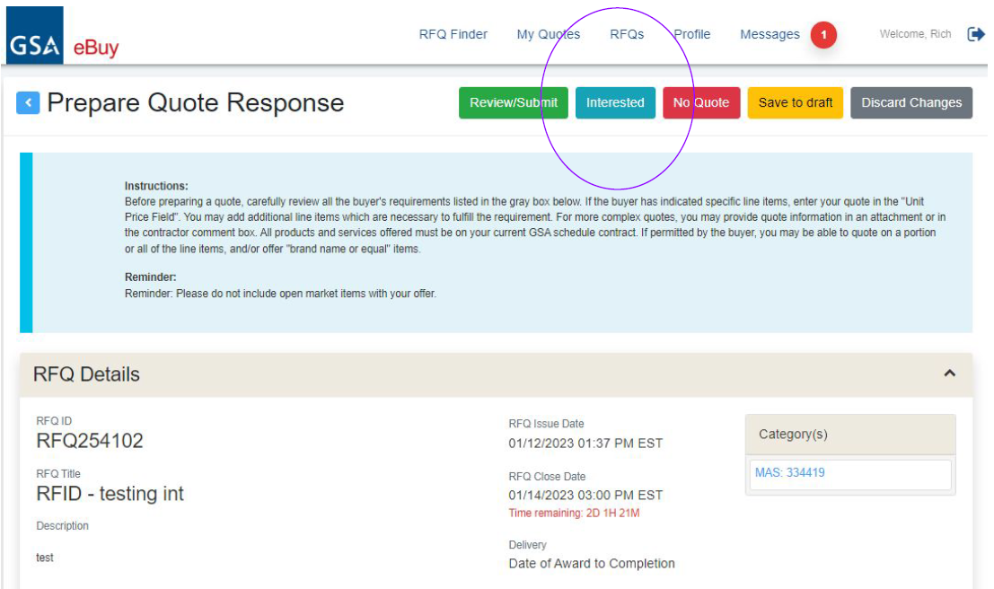
eBuy “Interested” Feature
Sellers can notify buyers that they are interested in an RFI/RFQ before submitting a response.
Seller’s My Quotes page will display all interested action.

Slide 17
Questions
How can I ensure my quote/proposal is responsive?
How does the government evaluate my quote/proposal?
Notes:
Kemba: I’d like to conclude today’s presentation with two of the most frequently asked questions regarding proposals and quotes. First – “How can I ensure my quote or proposals is responsive?”
Junaid
As mentioned earlier read and re-read the solicitation paying special attention to the Instructions and Evaluations sections. The solicitation will detail every item that is needed in the quote or proposal. I recommend making your own checklist to ensure that you are accounting for each of these. It’s not a bad idea to have a colleague do this as well, afterwards you can compare the lists to each other and ensure that your company is prepared to respond to each solicitation request. Responsiveness is the first hurdle to clear on your way to a successful quote or proposal – it’s certainly worth the extra time to get it right!
Kemba Our last frequently-asked question of the day! “How does the Government evaluate my quote or proposal?”
Junaid Each solicitation has a unique evaluation approach. However, the short answer is always the same – look in the solicitation. As we discussed earlier today, the solicitation will provide the evaluation criteria which will detail the basis of award, the evaluation factors (such as technical, cost, and SB utilization), and the relative importance of the evaluation factors – is technical more or less important than price? If any of these are confusing, use the Q&A period of the solicitation to ask for clarification.

Slide 18
MAS Resources for Assistance
www.gsa.gov/schedule
Email: MASPMO@GSA.GOV

Slide 19
Questions?

Slide 20
Thank You!

Slide 21
Survey
Please complete this short survey regarding the webinar.
Your feedback will help us enhance future training and identify ways to improve.
https://feedback.gsa.gov/jfe/form/SV_3mhlz28WFat7Jtk

