Slide 1
Why is Market Research Important?

Slide 2
Why is market research important?
Identifies Agencies buying what you sell
Awarded contracts and solicitation ID’s
NAICS / PSC used in solicitations
When contracts are expiring
Future opportunities because of expiring contracts
Understanding who your competition is
Possible subcontracting opportunities
Where contracts were performed

Slide 3
Freedom of Information Act (FOIA)
Since 1967, the Freedom of Information Act (FOIA) has provided the public the right to request access to records from any federal agency.
It is often described as the law that keeps citizens in the know about their government.

Slide 4
Find Your Source
There are several sources for spending information. We will discuss three sources:
  No cost options
    USAspending.gov
    FPDS
    Subscription Required
    PROXITY
  Raw Data exported in Comma Separated Values (CSV)

Slide 5
USASpending.GOV
Targeted Approach
Whether you're in marketing, business development, or just curious an Award Search will help you answer your toughest questions about federal spending.
Advanced Search offers filters that let you customize your data sets and the ability to download data files.
Export Results: Raw Data in Comma Separated Values (CSV). By selecting “Everything” during the download process, you will glean all of the available data about a contract.

Slide 6
Federal Procurement
Data System (FPDS)
What is included in the contract document:
Transaction information
Award Type, Contract Dates, Prepared User Email
Award ID and Solicitation Number
Obligation Amounts and Date Signed
Contracting Office ID (DoDAAC)
Contracting Office Name and Location
Awardee Legal Name, Address, UEI, Certifications, Type of Business
Principal Place of Performance
NAICS Code
Product Service Code
Description of Requirement
Government agencies are responsible for collecting and reporting data on federal procurements through the FPDS.
Contracting Officers (COs) must submit complete contract actions reports (CAR) within 3 days of the contract award.
Notes:
The federal government uses the reported data to measure and assess the impact of federal procurement on the nation’s economy, learn how awards are made to businesses in various socioeconomic categories, understand the impact of full and open competition on the acquisition process, and address changes to procurement policy.
The responsibility for the completion and accuracy of the individual contract action report (CAR) resides with the contracting officer who awarded the contract action.
The CAR must be completed in FPDS within three business days after contract award. Which means that data is available to you.
Why is this important? If you were not the successful bidder on a project then being able to see the information on the contract would reveal whether your bid was in the ballpark or way off base!
FPDS also gives you access to data downloads, but it is not as comprehensive nor is it user friendly. You have to know what you are looking for and how to sift through the data to find what you are looking for.

Slide 7
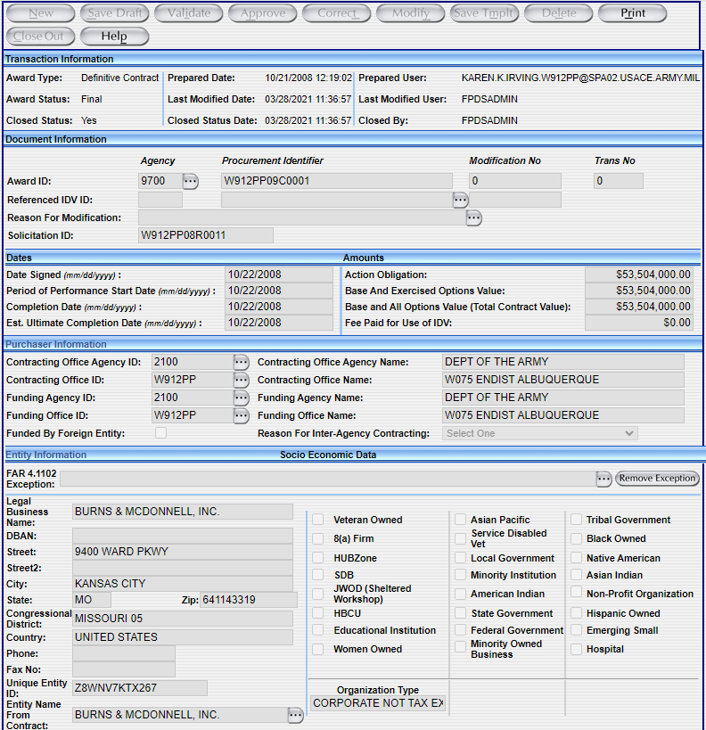
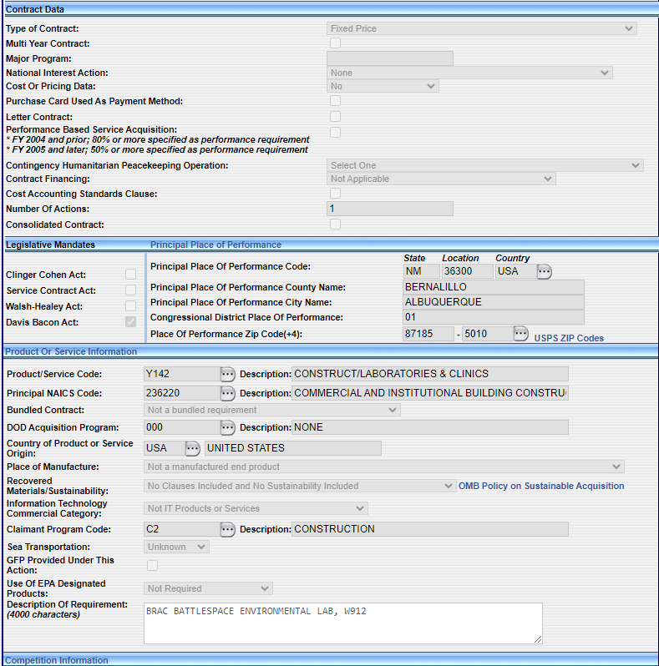
Contract Information

Slide 8
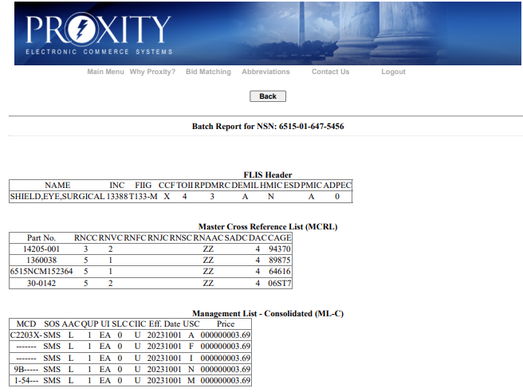
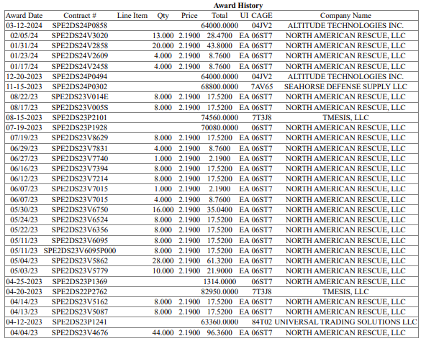
Proxity
About Proxity:
Subscription based
Pulls updates 4-times a day from data sources
Great contract reports
National Stock Number (NSN) searches and reports showing price, quantity, and vendor of item purchased
Forecasts
NAICS Code roadmaps of expiring contracts for the next 5-years.
Contracting Agencies searches

Slide 9
Interpretation of the Data
Exports that are CSV are long spreadsheets of data. Making it very difficult to organize and to drill down into the data.
The data must be put into a more reasonable format.
Excel has a tool called PIVOT TABLES which organizes the information so that you can drill down, or isolate, the data for analysis.

Slide 10
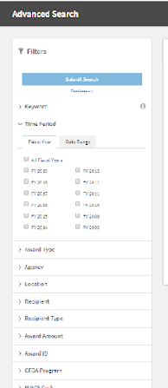
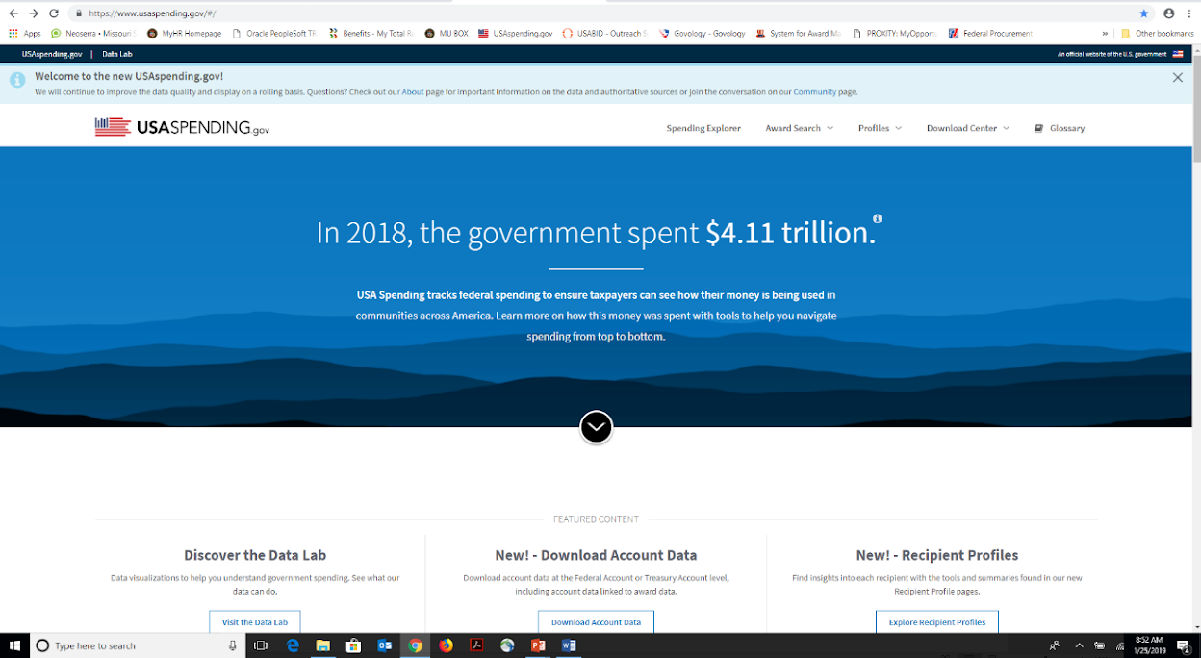
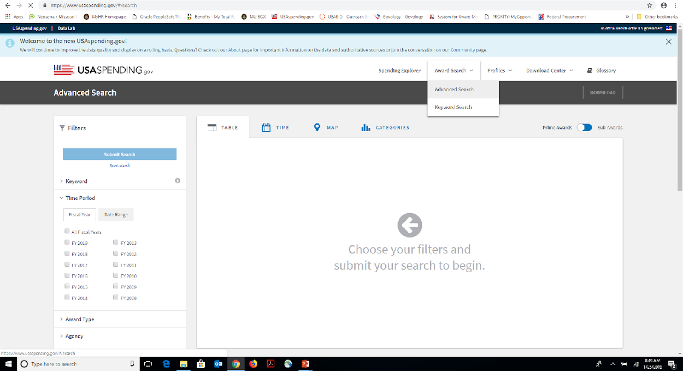
Go to USAspending.gov
Left Column FILTERS
Select Award Search
  Advanced Search

Slide 11
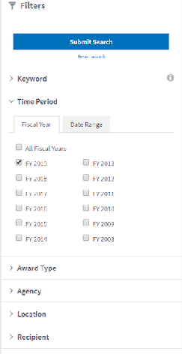
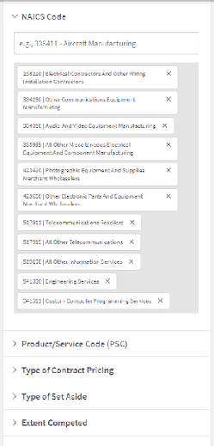
USASpending Filters
Choose your filters per client’s request.
Example Parameters Used:
Client needed all awards expiring in 2019
per their NAICS codes.
Reason:
Identify Agencies
Award contract and solicitation ID’s
NAICS / PSC used in solicitations
When contracts are expiring
Future opportunities because of
expiring contracts
Know their competition
Possible subcontract opportunities
Where contracts were performed

Slide 12
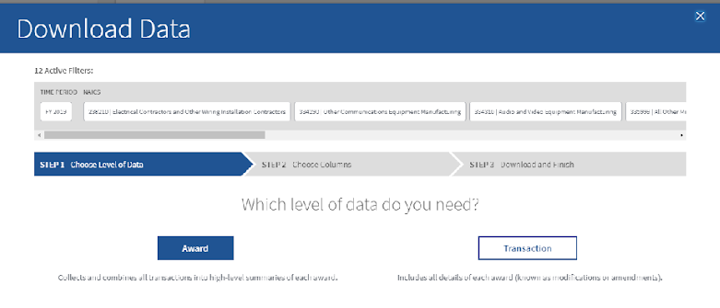
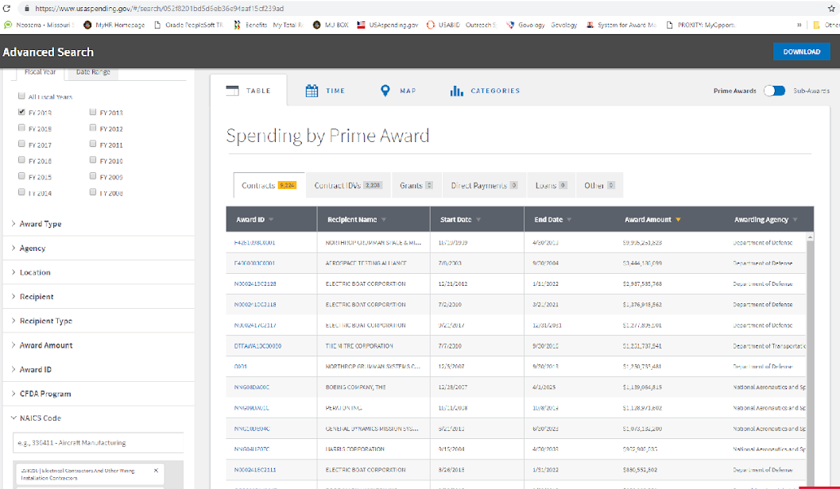

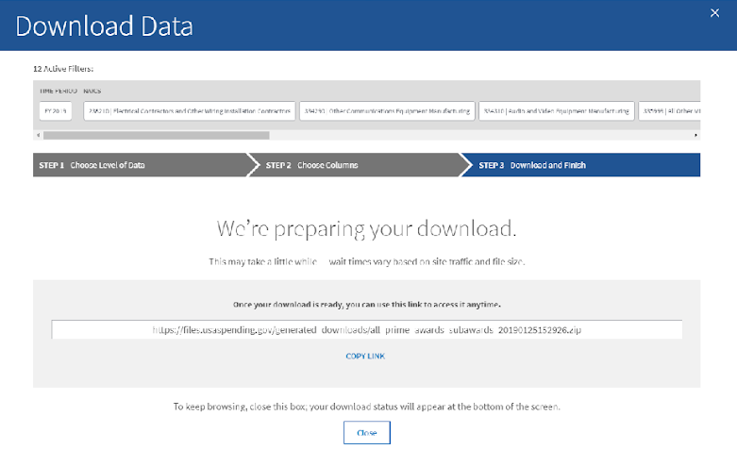
Results

Slide 13
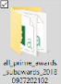
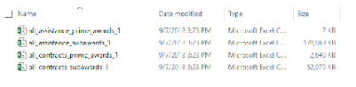
Slide title
The DOWNLOAD will include four files.
Use the all_contracts_prime_awards_1 file.

Slide 14
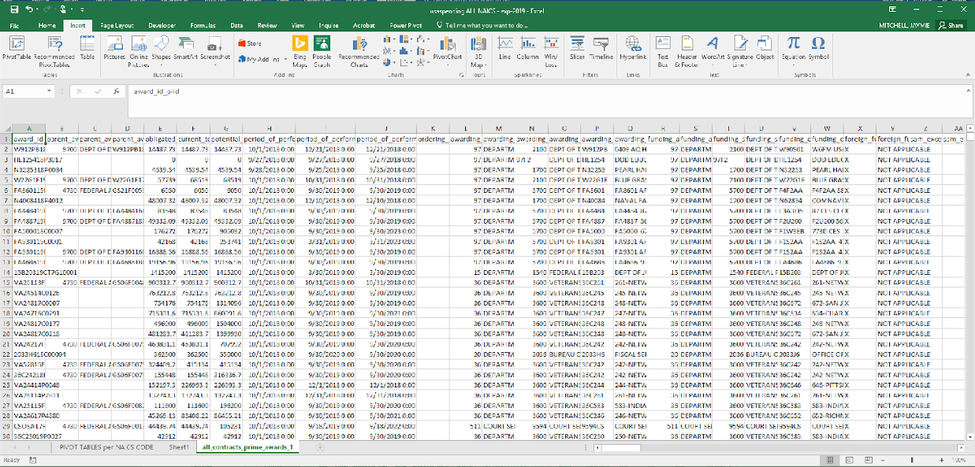
USASpending.gov CSV Data File

Slide 15
Steps to creating a Pivot Table
1. Review Data Columns
2. No Blank Rows
Be sure the data columns are in the right place.
  USA Spending is a clean export
  PROXITY at times the headers are off by one.
  It is good practice to just do a quick peruse for any obvious errors.
Just check to be sure there are no blank rows in your data.

Slide 16
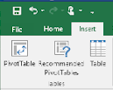
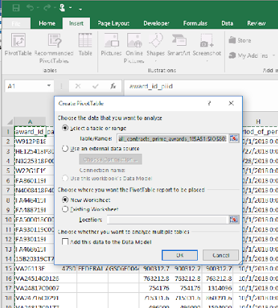
3. Data Table
Locate your curser and then click anywhere in the data table.
4. Insert Pivot Table
Located in the Tables group
under Insert in the menu bar
you will find PivotTable.
Click PivotTable.
The Table/Range is selected
by default.
Be sure that the first radio
buttons are selected:
  Select a table or range
  New Worksheet
Click OK and new worksheet
will be created

Slide 17
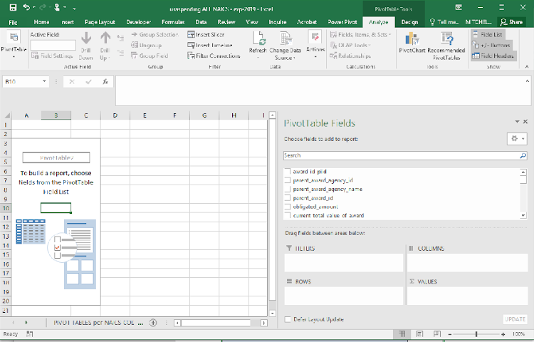
5. Building the PIVOT TABLE
First SORT your fields A-Z under the Settings dropdown. Choose your fields from the PivotTable Fields column on the right. Under ROWS add your fields.
Naics_code Awarding_agency_name Awarding_office_code Awarding_office_name Award_id_piid Solicitation_identifier | Period_of_performance Primary_place_of_performance_state_code Recipient_name Recipient_duns Period_of_performance_potential_end_date
Under VALUES add:
Obligated_Amount

Slide 18
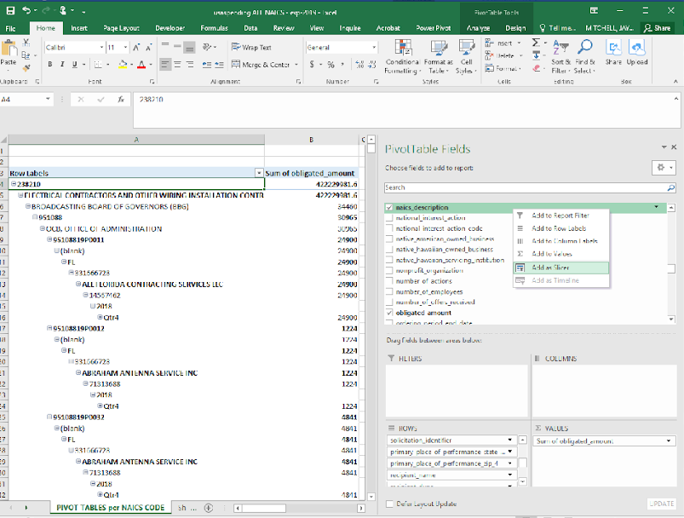
6. Adding Slicers
Go to the field you want to create a slicer for on the right side under PivotTable Fields.
Hover over the field and RIGHT CLICK.
Select ADD A SLICER
  A slicer gives you the ability to isolate information based on your selections.
  In other words, it lets you
  DRILL DOWN into specific data.

Slide 19
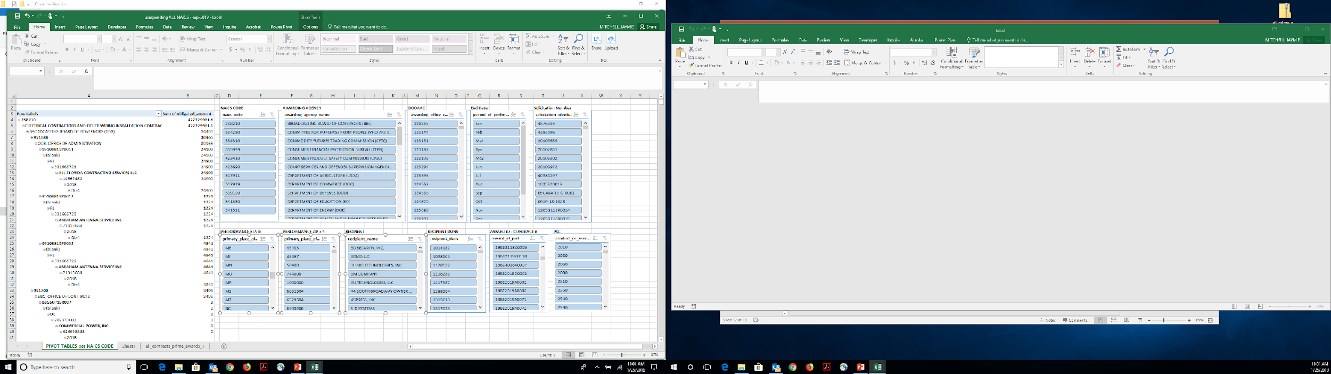
7. Final Worksheet

Slide 20
Missouri APEX Accelerator
University of Missouri
Jana Weitkemper
Program Manager
(573)882-9398
weitkemperj@missouri.edu
Columbia
  500 E. Walnut, Columbia MO 65201
  Kris Bockting
  (573)882-9398
  bocktingk@missouri.edu
Howell County Extension
217 S Aid Ave, West Plains MO 65775
  Willis Mushrush
  (417)256-2391
  mushrushw@missouri.edu
Springfield
  Allen Waldo
  (417)837-2612 waldoaj@missouri.edu
Kansas City
  Jeffrey Rosenblatt
  (816)235-6083
  rosenblattj@umkc.edu
Jason Cole
(816)235-2891
jcole@umkc.edu
Saint Louis
University of Missouri
9667 Page Avenue, Overland, MO 63132
  Jaymie Mitchell
  (314)376-5375
  mitchelljl@missouri.edu
  Gina Corce
  gcorce@missouri.edu
  Jon Hubach
  jhubach@missouri.edu
To find an APEX Accelerator in your state or near you go to
aptac-us.org

