Slide 1

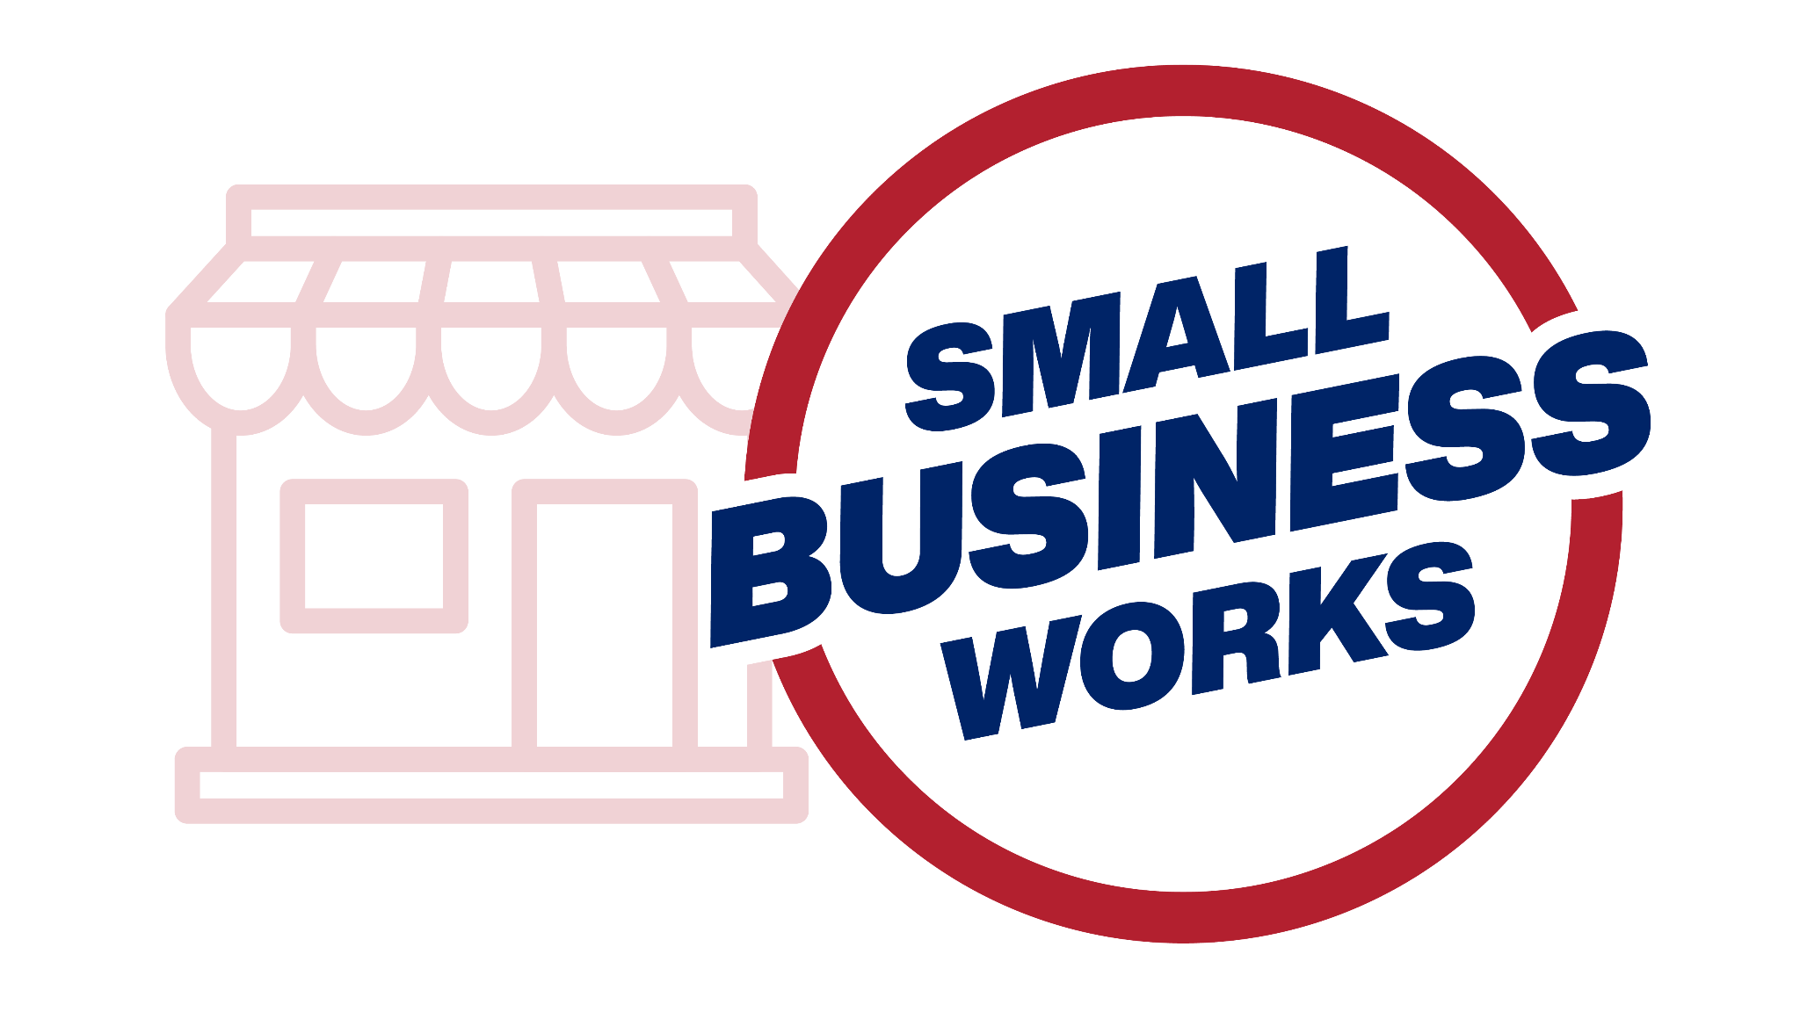
Small Business Works 2024
GSA OSDBU A.C.T.S on Maximizing Small Business Opportunities
U.S. General Services Administration

Slide 2
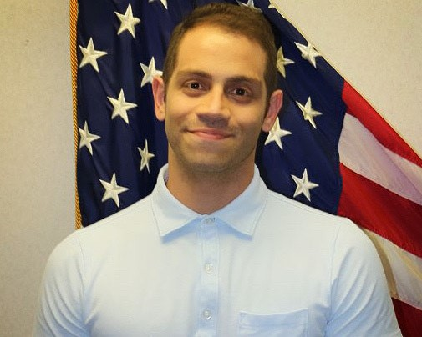

Guide to Federal Contracting
Igor Soares
Business Opportunity Specialist
SBA - Kansas City District Office

Slide 3
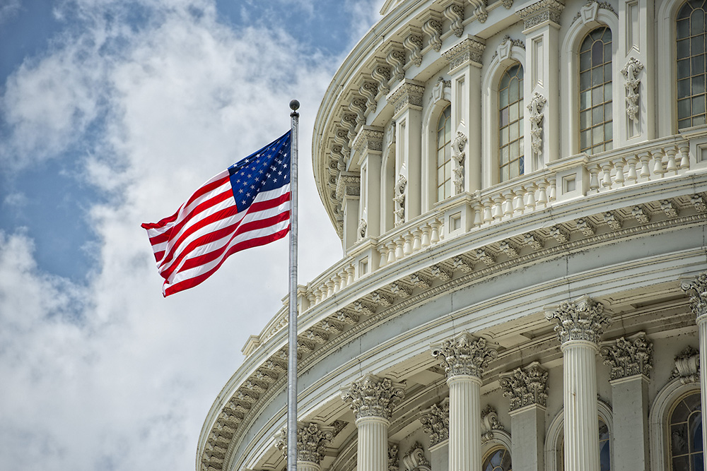


Contracting with the Federal Government
U.S. Government is the world’s largest customer, buying all kinds of products & services
Federal Agencies are required by law to provide contract opportunities to small businesses
SBA sets goals and monitors the federal government’s progress

Slide 4







What’s in it for a small business?
Diversify your customer base
Participate in a growth market
Even out cash flow
Develop a stable long-term client
Boost the reputation of your firm: Uncle Sam is a high-profile
Expand opportunities through joint ventures and sub-contracting
Contribute to the great mission of supporting the U.S.

Slide 5
The Federal Procurement Scorecard: Small Business Goals
The federal government’s objective to drive 23% of all federal procurement opportunities to small businesses also includes goals to expand opportunities for disadvantaged enterprises and communities.
Service-Disabled Veteran-Owned Business (SDVOSB)*
3%
Women-Owned Small Business (WOSB)
5%
23%
Small Business
11-14%
Small Disadvantaged Business (SDB)
Historically Underutilized Business Zone (HUBZone)
3%

Slide 6
Government-Wide Contracting Goals
COMPETITION TYPES TO WIN GOVERNMENT CONTRACTS
01
Full and Open
Competition
WORLD’S
LARGEST
BUYER
02
Small Business
Set-Asides
$500,000 billion/year
03
Sole Source
6
Notes:
6

Slide 7
Assess Your Business
Notes:
7

Slide 8
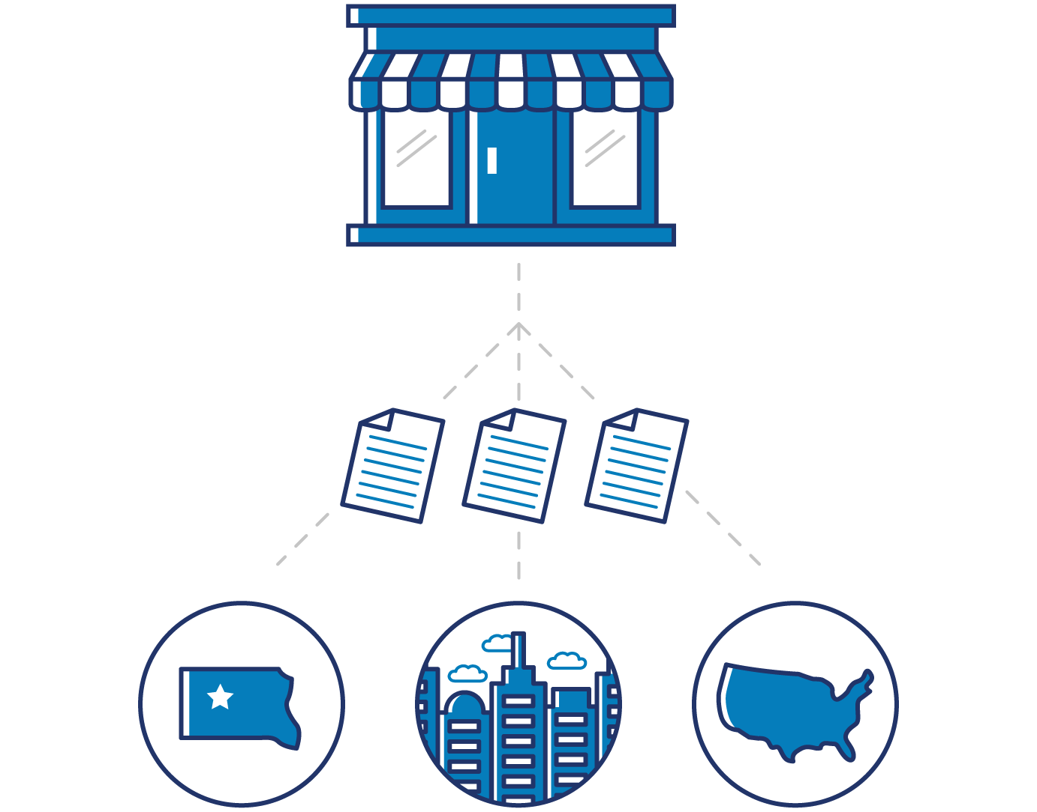
Are You a Small Business?
Size Standards
Determined by NAICS industry codes
Size Restrictions
Average number of employees or annual receipts
Non-Qualified Business
Primary operations outside the U.S.
Business Type
Sole proprietorship, partnership, corporation, or any other legal form
Other
Non-profit businesses are not considered
Location
Operates primarily within the U.S.
8
Notes:
8

Slide 9



Do You Know Your NAICS Codes and Size Standards for Your Industry?
SBA size standards using NAICS as their basis apply to all Federal government programs, including procurement
NAICS codes define establishments and are used for administrative, contracting, and tax purposes
Visit the United States Census Bureau NAICS website to identify your NAICS code(s)
9
Notes:
9

Slide 10

Is Your Business Ready?
Does the Government…
Buy what you sell
Do you have…
Federal contracting experience
Cash, inventory, working capital
Are you capable…
Of fulfilling a government contract
Do you know…
Where to find contracting opportunities
Notes:
10

Slide 11
Certification Programs
Notes:
11

Slide 12
HUBZone Program Overview

Slide 13
HUBZone Program Mission
Launched in 1999, the HUBZone Program fuels the development of distressed communities by providing small businesses preferential access to federal government contracts.
  Federal Government has goal to award 3% of procurement to HUBZone-certified small businesses via set-aside and price preference awards.
  Small businesses become certified by locating in and employing residents (35%) from qualified HUBZones.
  HUBZone communities benefit from jobs and investment.
HUBZone Communities
Small Businesses
Federal Government

Slide 14




Benefits of HUBZone Certification
Qualify for a set-aside or sole source contract, or a 10% price preference in full and open competition, available only to certified HUBZone firms
Build past performance history as a prime, sub, or joint venture partner by contributing a valuable certification to non-HUBZone set-aside proposals
Access specialized training and assistance reserved only for SBA certified firms
Make an impact in an underserved area by investing in the community and creating jobs

Slide 15
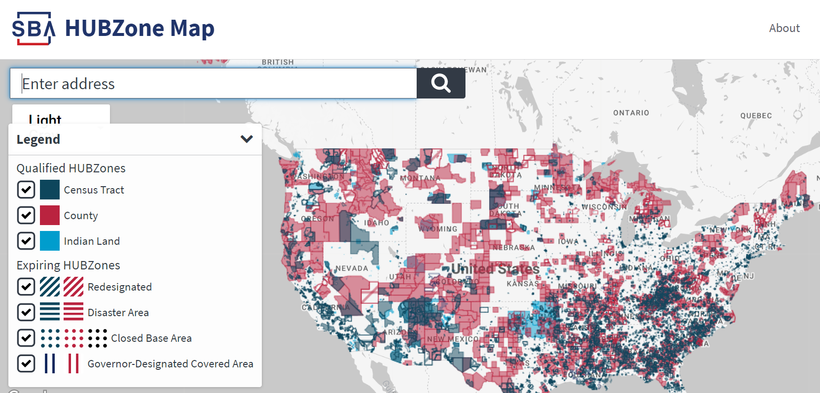
HUBZone Designations
There are six different designations:
Qualified Census Tract
Qualified Non-Metropolitan County
Indian Land
Disaster Area
Redesignated (transition)
New in 2020: Governor’s Designated (rural) Areas.
More than 22,000 communities
Footprint expanding

Slide 16


Snapshot of HUBZone Firms
+/- 4,000 certified HUBZone enterprises
40% of HUBZone firms are dual certified
65% self-certified as SDB
70% of HUBZone firms are in Professional and Technical Services or Construction
2,550 HUBZone firms were awarded contracts totaling more than $16.3 billion in FY22, equating to more than 71,000 jobs.
Typical firm entering: $400K AGI, 5 employees, 8 years old
5 years later: $1 million, 8 employees

Slide 17
HUBZone Continuing Eligibility
Firms must:
Complete an annual recertification attestation.
Participate in a program examination at least once every three years; more often if they receive a HUBZone set aside contract.
Notify SBA if their business is involved in a merger or acquisition.
Not drop below 20% HUBZone residency while performing on a HUBZone contract.
Comply with regulations.
Firms may:
Continue in the program for as long as they qualify.
Fall in and out of compliance throughout the year but must meet eligibility requirements each year on the certification anniversary date.

Slide 18
Women-Owned Federal Contract Program

Slide 19

WOSB Federal Contract Program
Launched in 2008; industries where WOSBs have been underrepresented
Take advantage of annual prime contracting goals
Access set-asides for WOSBs and EDWOSBs
Build capacity and grow

Slide 20



Unique Aspects of the WOSB
Federal Contract Program
    Many NAICS codes are now authorized for use under the WOSB Federal Contract Program. Check sba.gov/wosbready for available NAICS (733).
WOSBs and EDWOSB must receive certification through WOSB.certify.sba.gov in order to be eligible to compete on set-aside and sole-source contracts.
COs must verify WOSB and EDWOSB certification on the Dynamic Small Business Search (DSBS) database.
Build capacity and grow

Slide 21






Is the WOSB/EDWOSB Certification
Appropriate for You?
Managerial experience
51% ownership requirements
Highest officer position
Management of daily operations
Seeking federal contracting opportunities
No minimum time in business

Slide 22



Economically Disadvantaged
Requirements to Qualify
Personal net worth (assets minus liabilities) less
than $850,000
Three-year average income is $400,000 or less
Fair market value of all assets is $6.5 million or less

Slide 23
WOSBs and EDWOSBs
WOSB
WOSB: Women-Owned Small Business
EDWOSB: Economically Disadvantaged Women-Owned Small Business; WOSBs whose owner and/or manager claims economic disadvantage
EDWOSB is a subset of WOSB. As such, if you qualify as an EDWOSB, you automatically qualify as a WOSB.
EDWOSB

Slide 24

Changes to Remember
The self-certification process is no longer available in certify.sba.gov. All Firms seeking to participate in the program must apply via WOSB.Certify.sba.gov. SBA will accept certification from current and active 8(a) or VA CVE/SBA VetCert certified firms.
Third-party certified firms MUST submit their TPC certificate to WOSB.Certify.sba.gov for SBA to display their WOSB certification.
All firms seeking to participate in the WOSB Federal Contract Program, WOSB or EDWOSB set-aside contract or sole source must be certified.
Verification of a firm’s WOSB Certification can be viewed on the firm’s Dynamic Small Business Search (DSBS) profile under Federal Certifications section.

Slide 25
8(a) Business Development Program

Slide 26

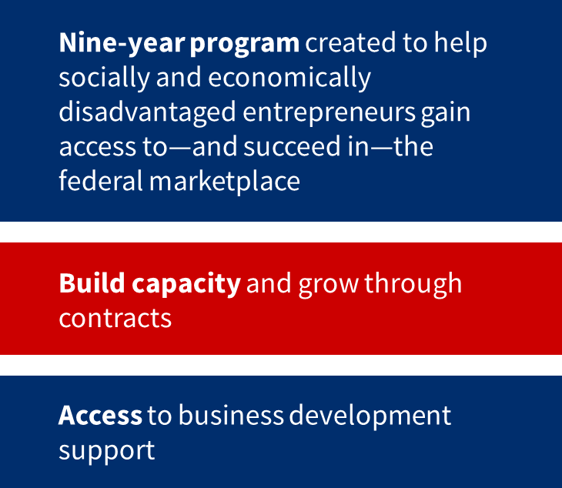
8(a) Business Development Program

Slide 27
Program Purpose
8(a) certification is a path to new business growth for small businesses.
The 8(a) BD Program diversifies small businesses’ revenue streams with federal contracting dollars. Qualified 8(a) businesses can create new business paths and jobs through increased revenues from government contracting.
Through the 8(a) BD Program, the SBA provides small disadvantaged businesses with exclusive access to reserved federal contracting opportunities and a unique opportunity for direct contract awards.

Slide 28
Program Overview
Businesses that participate in the 8(a) BD Program receive training and technical assistance, business development services, exclusive access to reserved federal contracting opportunities, and a unique opportunity for direct contract awards.
Federal contracting officers see 8(a) certification as a valuable asset. They understand that 8(a) certification represents exclusive access to uniquely qualified small disadvantaged business entrepreneurs who are ready to do business with the federal government.

Slide 29
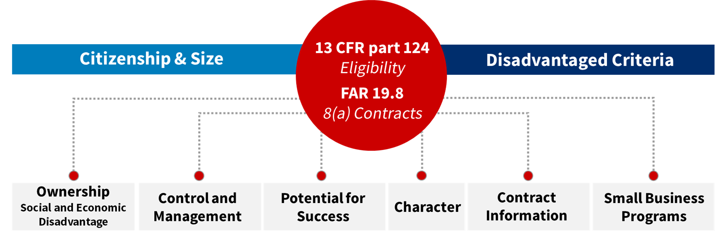
Know the Rules for 8(a) Certification

Slide 30
Economically Disadvantaged
Requirements to Qualify
Personal net worth (assets minus liabilities) less
than $850,000
Three-year average income is $400,000 or less
Fair market value of all assets is $6.5 million or less

Slide 31
Socially Disadvantaged Criteria
Preponderance of evidence
Race, ethnicity, gender, physical handicap, long-term environmental issues
Chronic and substantial social disadvantaged
Negative impact to business advancement

Slide 32
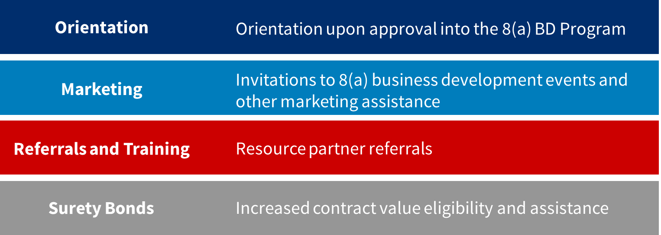
Business Development Assistance Available to
Program Participants

Slide 33
Veteran Small Business Certification Program

Slide 34
Veteran Small Business Certification Program
The National Defense Authorization Act of 2021 officially required the Dept. of Veterans Affairs’ (VA), Center for Verification and Evaluation’s (CVE) responsibilities to be:
  Transferred to SBA as of Jan 1, 2023
  SBA to establish a government-wide certification program.
    SBA’s program Veteran Small Business Certification Program (VetCert).
  Program’s final rule was published to the Federal Register, Nov 29, 2022
  Program launched and started accepting applications Jan 9, 2023
    Veterans.certify.sba.gov
    First application approved same day January 9, 2023.
    Since that time VetCert has approved over 9300 applications to date.
    Approval rate 85% of all submitted applications
    Software for system called Veterans Case Management System (VCMS)
Last Fiscal Year 22 billion dollars were awarded to Veteran Owned Small Business Federal wide.

Slide 35
Policy Highlights – Key Changes
Certification: SDVOSBs need to be certified by the SBA to receive sole-source or set aside contracts from any federal agency
  SDVOSB government-wide goal is still 3%*
  Agencies can still rely on self-certification for goaling purposes
VA Acquisition: VOSBs continue to need to be certified for sole-source and set aside contracts from the VA under its Vets First Authority
  Other federal agencies do not have a mandate or authority to award contracts to VOSBs
VetCert System: The SBA has both the certification system (for small businesses to apply/reapply) and the search tool (for the public & acquisition professionals)
  SAM.gov will not accurately reflect SDVOSB/VOSB certification status
Joint ventures do not require certification although the managing partner must be SBA certified and the joint venture must request designation.

Slide 36
Policy Highlights – Key Changes (cont.)
One Year Extension - Companies that were verified by the VA Center for Verification and Evaluation (VA CVE) prior to January 1, 2023, have automatically received a 1-year extension to their program term (4 years vs. 3 years)
One Year Grace Period - Companies may self-certify through 2023, but must also submit an application to SBA for a final determination
Certification will not be for a specific NAICS code - SBA’s certification process determines that a business is currently small in at least one NAICS code listed in the firm’s SAM.gov profile. To avoid restricting a certified VOSB/SDVOSB’s ability to expand its operations into new industries, a firm must only qualify under the size standard corresponding to the NAICS code assigned to a specific contract.
Final Rule takes steps to harmonize & simplify definitions of ownership, control, day to day operations, and standard hours across certification programs
OHA handles appeals & protests
Goaling Credit For now, agencies will continue to receive SDVOSB goaling credit for awards made to self-certified SDVOSB on non-SDVOSB set aside or sole source contracts. The SBA intends to reevaluate self-certification for goaling purposes once this program is launched.

Slide 37

Eligibility
To apply for certification as a VOSB or SDVOSB, a firm must meet the following requirements:
Owners identified by Veteran Affairs as a veteran and or service-disabled veteran
Be considered a small business as defined by the size standard corresponding to any NAICS code listed in the business’s SAM profile (SAM registration required).
No less than 51 percent of the business owned and controlled by one or more veterans.
For certification as a SDVOSB, no less than 51 percent owned and controlled by one or more service-disabled veterans. For those veterans who are permanently and totally disabled and unable to manage the daily business operations, the spouse or permanent caregiver qualifies.

Slide 38

Transfer of VA Verified Businesses to SBA
The transfer of VA verification to the SBA requires nothing from the business owner.
The SBA is accepting all businesses verified by the VA as SBA-certified.
All documents and data were transferred via data transfer so that those documents reside in the new SBA system.
Business owners should verify that the email address used to register a VetCert account is the same email address used in their prior CVE verification. If it is different, contact VetCert Customer Service, 1-800-862-8088.

Slide 39

How Does a Business Prepare for Application?
Step 1: Determine eligibility.
The business owner must be a veteran or a service-disabled veteran as established in Title 38 CFR Part 74 or 13 CFR Part 128.
Be considered a small business as defined by the size standard corresponding to at least one NAICS code listed in the business’s SAM.gov profile.
No less than 51 percent of the business must be owned and controlled by one or more veterans.
For certification as a SDVOSB, no less than 51 percent of the business must be owned and controlled by one or more veterans rated as service-disabled by VA.
For those veterans who are permanently and totally disabled and unable to manage the daily business operations of their business, their business may still qualify for certification as an SDVOSB if their spouse or appointed permanent caregiver is assisting in that management.
Step 2: Ensure registration in SAM.gov. The business MUST be registered in SAM.gov to move forward.
Step 3: Gather required documentation before beginning the application. A fact sheet listing required documentation is available at sba.gov/vetcert.

Slide 40
SBA Certification Process Flow
Application Submission
Intake
Assessment
Decision
Veteran creates application and uploads required business documents
Owners upload required personal documents and sign VA Form 0877
Intake Analyst validates basic eligibility requirements
Intake Analyst requests sent to Veterans any documents that need to be sent prior to application phase
Level One Analyst Confirms receipt of all required documents; requests clarifying information as needed
reviews entire application to assess regulatory compliance
Level 2 Analyst reviews complex case fact patterns
initiates deficiency process as needed
All Analysts submit recommendation to approve, deny, or remove application
Federal Reviewer reviews’ final case documents.
Federal Reviewer makes final recommendation to approve or deny the application. Reviews and signs the final determination letter
Less documentation required then previous process
New software easy to navigate
Allows for reciprocal qualification with other SBA qualifying set aside programs.

Slide 41

Helpful Resources for Small Businesses
Contact your local SBA office to learn more Federal Certifications.
Government contracting assistance, consulting, and workshops APEX Accelerators.
Visit SBA’s Federal Contracting page at www.sba.gov for contracting assistance program updates.
Go to certify.sba.gov and visit the Certify Knowledge Base for all tools, FAQs, and program information for 8(a), Mentor-Protégé, WOSB, and HUBZone.

Slide 42
Questions?

Slide 43
SBA

Slide 44
Thank You!

