Slide 1

GSA e-Tools:
The Tools Available For You!
Jemeek Morris & Kevin Pope
Small Business Specialists
Office of Small & Disadvantaged Business Utilization
Small Business Advocacy & Engagement (SBAE) - East
U.S. General Services Administration

Slide 2

AGENCY OVERVIEW
The U.S. General Services Administration’s (GSA) mission is to deliver value and savings in real estate, acquisition, technology and other mission support services across the Federal government.
GSA is the Federal government’s procurement expert, helping other agencies acquire space, products, and services needed from commercial sources.
The Public Buildings Service (PBS) http://www.gsa.gov/pbs, provides real estate space, architecture, interior design, and construction to Federal agencies.
Our Federal Acquisition Service (FAS) http://www.gsa.gov/fas delivers a vast number of commercial goods and services, at the best value, across government and manages our Multiple Award Schedules program.

Slide 3
AGENCY OVERVIEW: PBS
Public Building Service (PBS)
As the Landlord for the civilian federal government, PBS acquires space on behalf of the federal government through new construction and leasing, and acts as a caretaker for federal properties across the country.
PBS owns or leases 8,800 assets, maintains an inventory of more than 370 million square feet of workspace, and preserves more than 500 historic properties.
http://www.gsa.gov/pbs
What Does PBS Procure?
Construction
A&E Services
Janitorial
Landscape
Interior Design
Asbestos Removal
HVAC
Lighting
Security
Window Washing
Painting
Electrical
Lease
And More
Where are the PBS Opportunities?
GSA Forecast
GSA Subcontracting
Sam.gov
GSA Multiple Award Schedules (MAS)
Indefinite Delivery Indefinite
Quantities (IDIQ)
www.gsaauctions.gov

Slide 4
AGENCY OVERVIEW: FAS
Federal Acquisition Services (FAS)
GSA is America's only source solely dedicated to procuring goods and services for government.
As an integral part of GSA, FAS possesses unrivaled capability to deliver comprehensive products and services across government at the best value possible.
http://www.gsa.gov/fas
What Does FAS Procure?
Environmental
Moving Services
Staffing
Information Technology
Transportation
Law Enforcement
Equipment
Furniture
Professional Training
Telecom & Network Services
Travel Services
Emergency Preparedness
& Response Equipment
And Much More…
Where are the FAS Opportunities?
GSA Forecast
GSA Subcontracting
Sam.gov
GSA Multiple Award Schedules
(MAS)
Indefinite Delivery Indefinite
Quantities (IDIQ)
Governmentwide Acquisition
Contracts (GWAC)

Slide 5
OSDBU OVERVIEW
Office of Small & Disadvantaged Business Utilization (OSDBU)
According to the Small Business Act as amended by Public Law 95-507, the Office of Small & Disadvantaged Business was established to:
  Advocate, within each Federal Executive Agency, for the maximum practicable use of all designated small business categories within the Federal Acquisition process.
  Ensure inclusion of small businesses as sources for goods and services in federal acquisitions as prime contractors and subcontractors.
  Manage the small business utilization programs for each respective organization.
https://www.gsa.gov/small-business

Slide 6
OSDBU OVERVIEW CONT’D
OSDBU engages in activities that make it possible for the small business community to meet key contracting experts and be counseled on the procurement process. OSDBU monitors and implements small business policies and manages a range of programs mandated by law. These programs include:
Small Business Goaling Program
*Small Disadvantaged Business (SDB) Program (which includes the 8(a) businesses)*
*8(a) Business Development Program*
*Women-owned Small Business Program*
*Historically Underutilized Business Zone (HUBZone) Program*
*Service Disabled Veteran-owned* & Veteran-owned Small Business Small Business Programs Subcontracting Program
*SBA’s federally recognized socio-economic categories*
https://www.sba.gov/partners/contracting-officials/small-business-procurement/set-aside-procurement
https://www.sba.gov/federal-contracting/contracting-assistance-programs

Slide 7
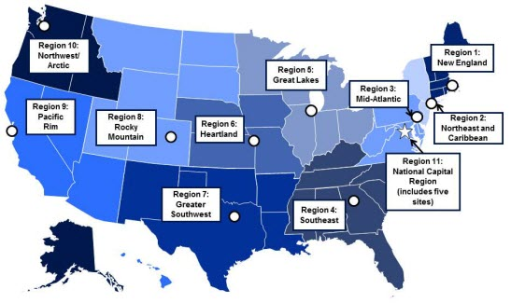
OSDBU OVERVIEW CONT’D
Region 1: Boston, MA
Region 2: New York, NY
Region 3: Philadelphia, PA
Region 4: Atlanta, GA
Region 5: Chicago, IL
Region 6: Kansas City, MO
Region 7: Ft. Worth, TX
Region 8: Denver, CO
Region 9: San Francisco, CA
Region 10: Auburn, WA
Region 11: Washington, DC
https://www.gsa.gov/small-business/small-business-resources/contact-information-for-small-business-support

Slide 8
Accessing
GSA’s eTools

Slide 9

Today’s GSA eTool Agenda
SAM.gov - System for Awards Management
FPDS - Federal Procurement Data System
U.S.A. Spending
GSA eBuy
GSA eLibrary
GSA Forecast Tool
GSA Subcontracting Directory

Slide 10
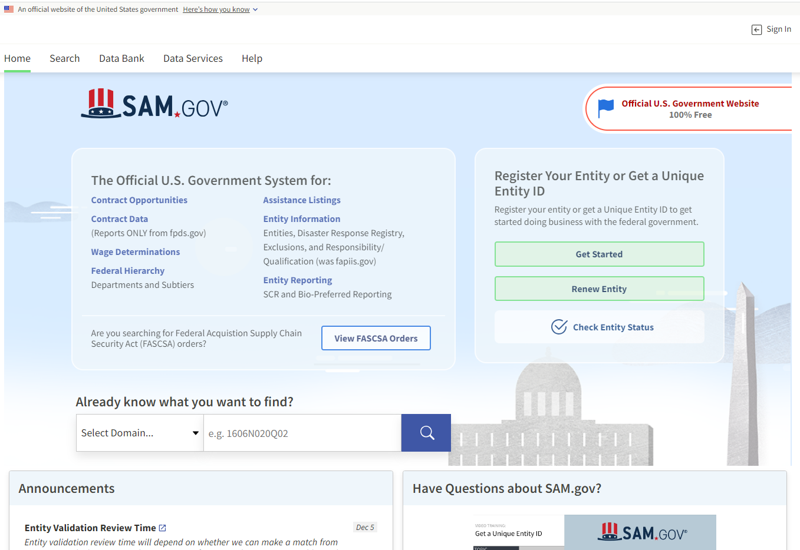
System for Award Management (S.A.M.)
SAM.Gov includes the following:
Contract Opportunities: (Formerly fbo.gov)
Contract Data: (Reports only. From fpds.gov)
Wage Determinations: (Formerly wdol.gov)
Entity Registration: (Combined with the former beta.sam.gov)
Entity Reporting
Assistance Listings: (Formerly cfda.gov)
https://sam.gov/content/home

Slide 11
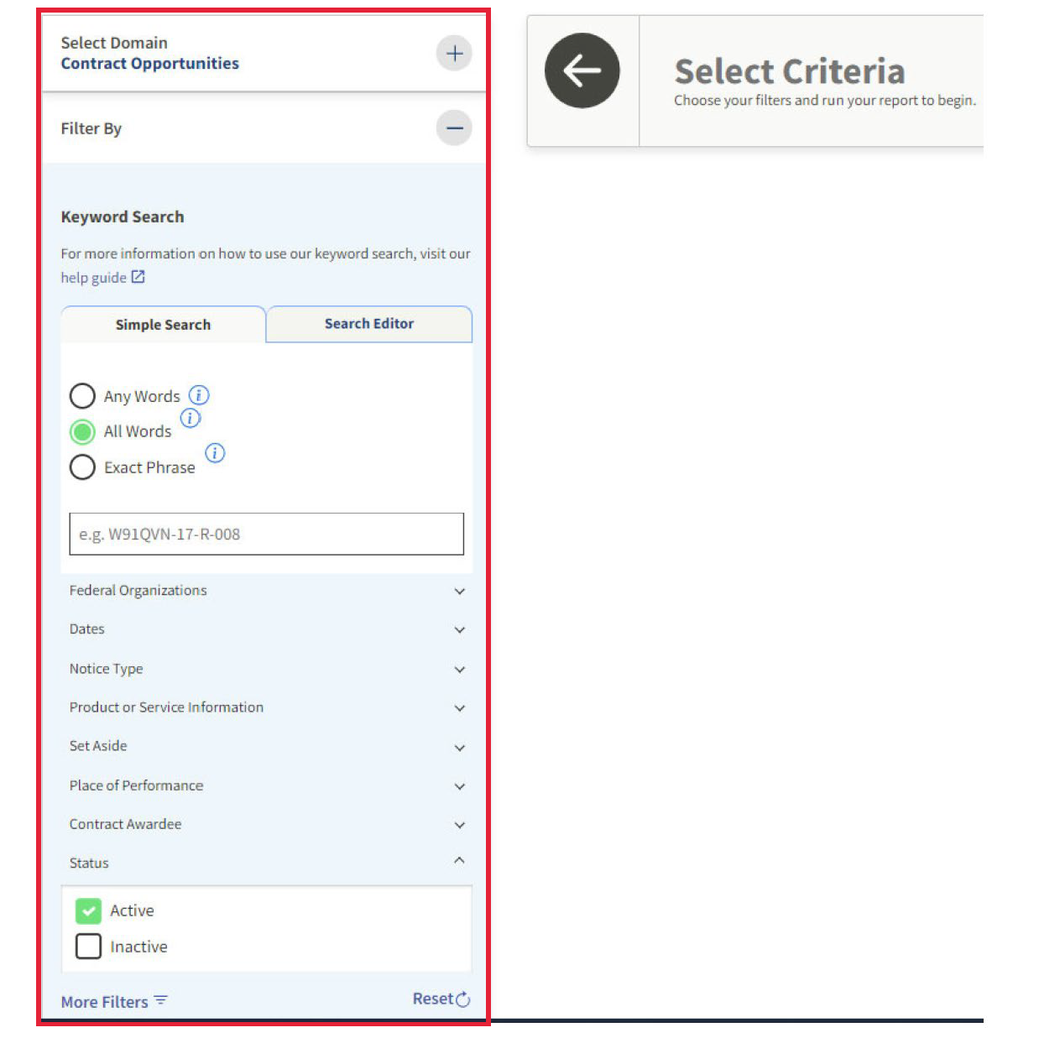
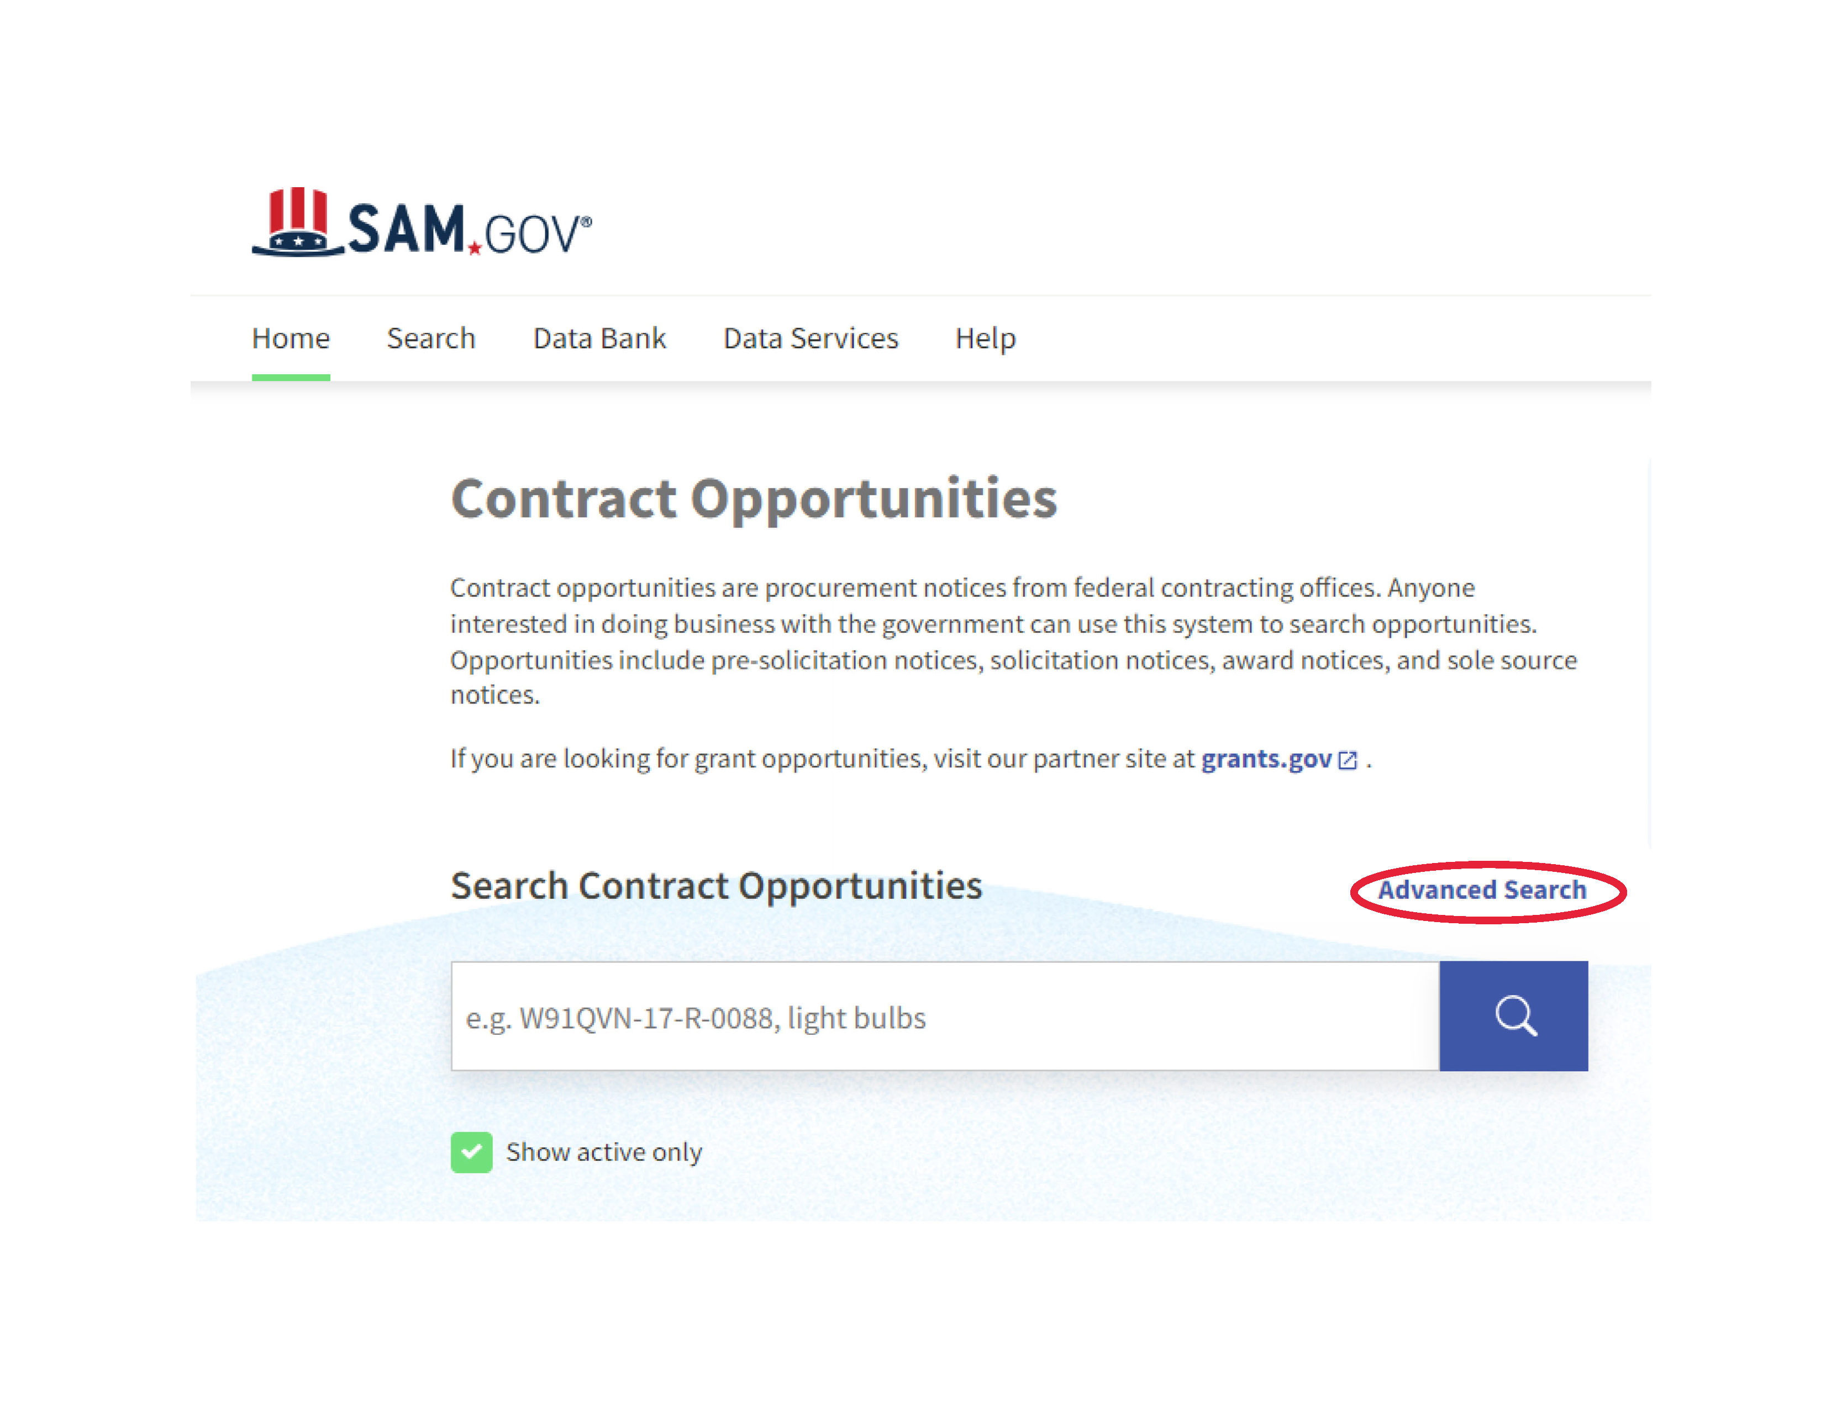
SAM.GOV

Slide 12
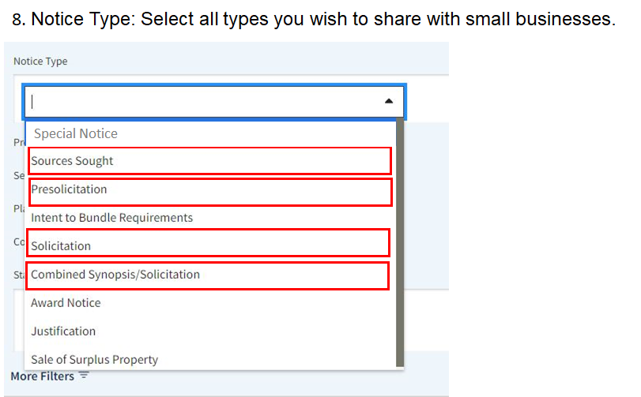
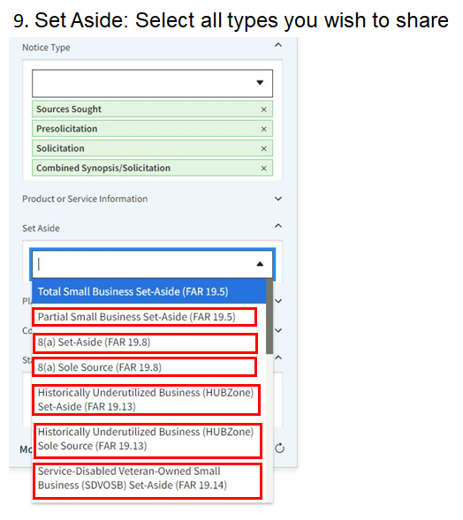
SAM.GOV

Slide 13
Sources Sought Notice
What is a Sources Sought Notice? | Method of Market Research Published on the SAM.GOV website Invaluable for determining availability of capable small businesses, 8(a), HUBZone, Woman-Owned or SDVOSB concerns Provides an excellent documentation to support chosen acquisition strategy
Why Respond to a Sources Sought Notice? | Used to identify potential sources -For construction set aside only for 8(a), SDVOSB, WOSB and HUBZone concerns Used to determine Small Business Set-aside -If two (2) or more Small Businesses can be determined by the Government to be capable of performing the task Information used to set Small Business subcontracting goals if the requirement is not set-aside and is over $750,000* for products/services or $1.5M for Construction
Sources Sought Notice Tips | Outline the Company Capability Statement so that it addresses requirements in the same order provided in the Sources Sought Notice Relevant Past Performance means citing contracts your company has performed which involved the same or very similar scope

Slide 14
FPDS-NG Overview
What’s reported to FPDS-NG? Agencies are required to report on all contract actions using appropriated funds whose estimated value is $3,500 or more as specified in FAR 4.6 Contract Reporting.
Where the data is from: Contracting Officers enter the procurement data directly, or the data is fed from 90+ agency contract writing systems
Oversight: Operated by GSA IAE with Governance from Acquisition Committee for eGov, Procurement Committee for eGov, Financial Assistance Committee for eGov, and IAE CCB
For more details visit: https://www.fpds.gov

Slide 15
What is needed to use FPDS?
Your Product Service Code (PSC)
1. Industry Classification used to identify specific types of industry.
2. North American Industry Classification System (NAICS) is a broad classification
3. The NAICS is what you do
NAICS
1. PSC’s can help you narrow down exactly what your business does
2. PSC’s are specific and can yield better data for market research and analysis
3. Your PSC is how you are doing it
PSC

Slide 16

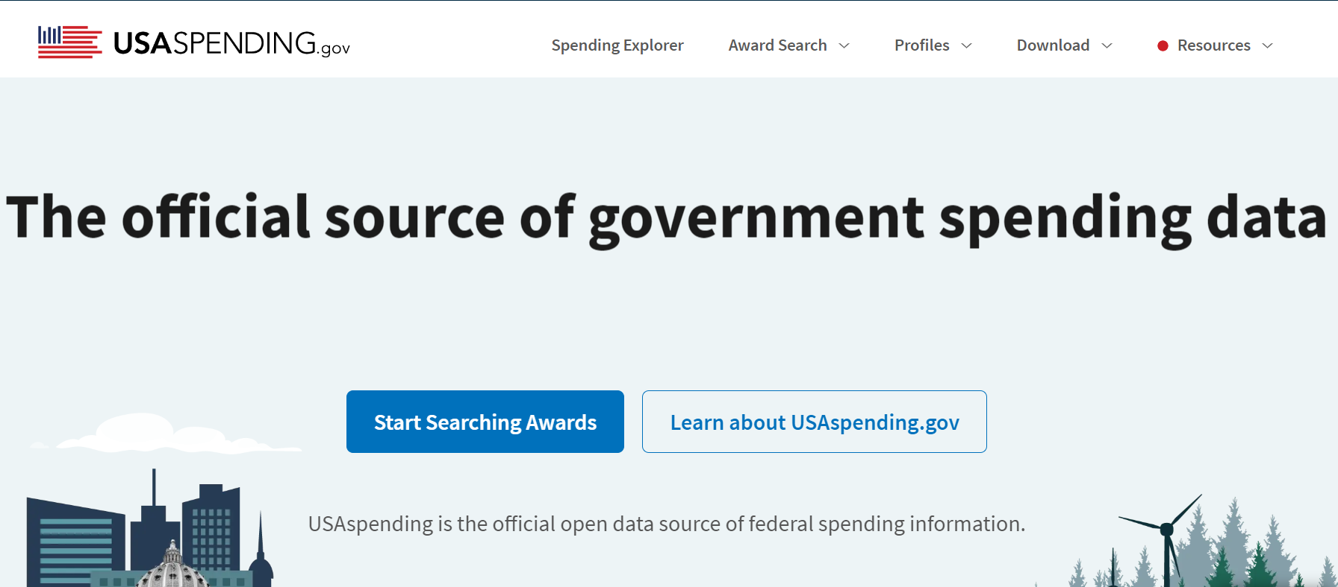
USA Spending
USA Spending is another tool that can be used for conducting marketing analysis. It is a government source for data on federal grants, contracts, loans, and other financial assistance.
For more details visit: www.usaspending.gov

Slide 17
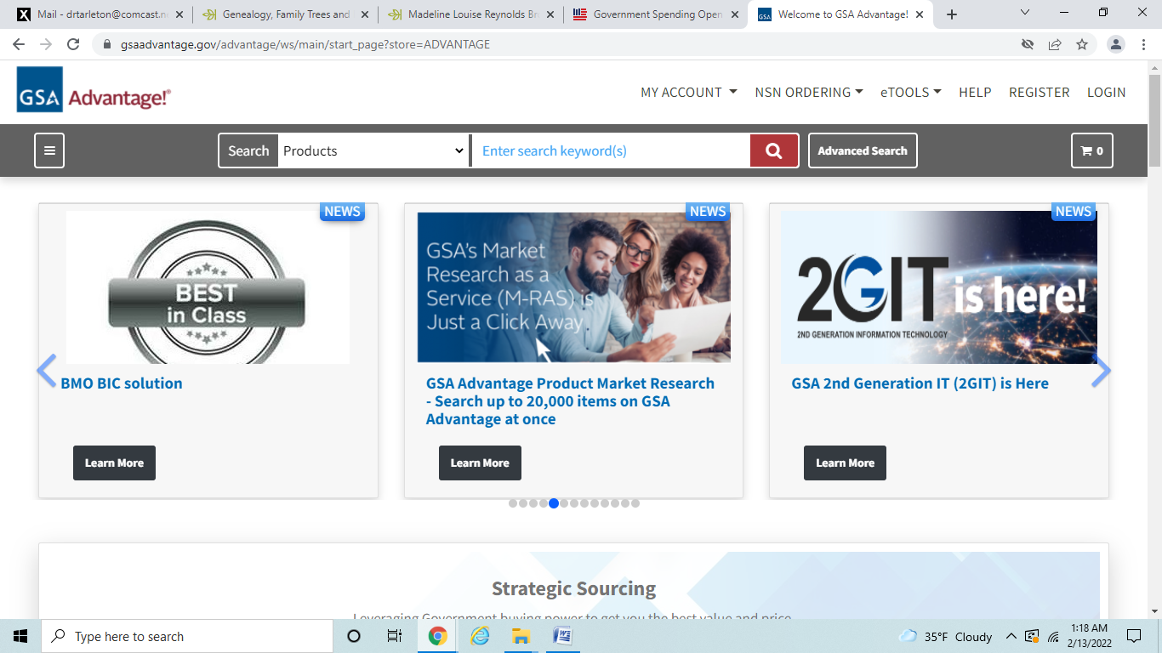
GSA Advantage.gov
GSA Advantage - https://www.gsaadvantage.gov is the online shopping and ordering system that provides access to thousands of contractors and millions of supplies (products) and services. Anyone may browse on GSA Advantage.gov website to view and compare the variety of products and services offered.
Buyers - GSA Advantage Customer Service Sellers - Vendor Support Center
Phone: 1-877-472-3777 Phone: 1-877-495-4849
Email: GSA.Advantage@gsa.gov Email: vendor.support@gsa.gov

Slide 18
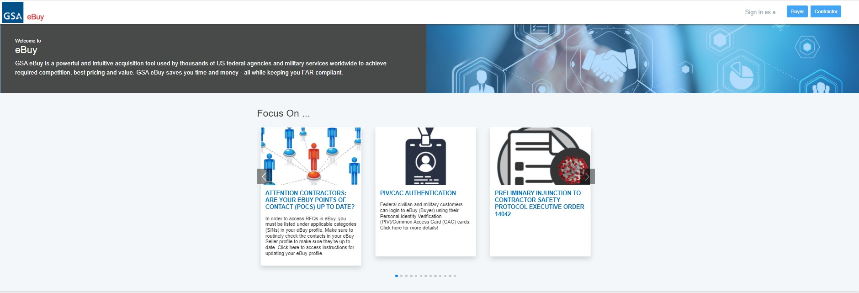
GSA eBuy
Federal agencies (buyers) can utilize the eBuy system - http://www.gsa.gov/ebuy to prepare and post Requests for Quotations (RFQs) for specific supplies (products) and services offered under GSA and VA Multiple Award Schedules (MAS) also referred to as Federal Supply Schedules contracts); Network Services and Telecommunications contracts; Blanket Purchase Agreements (BPAs) and Federal Strategic Sourcing Initiative (FSSI) contracts.
Buyers - GSA Advantage Customer Service Sellers - Vendor Support Center
Phone: 1-877-472-3777 Phone: 1-877-495-4849
Email: GSA.Advantage@gsa.gov Email: vendor.support@gsa.gov

Slide 19
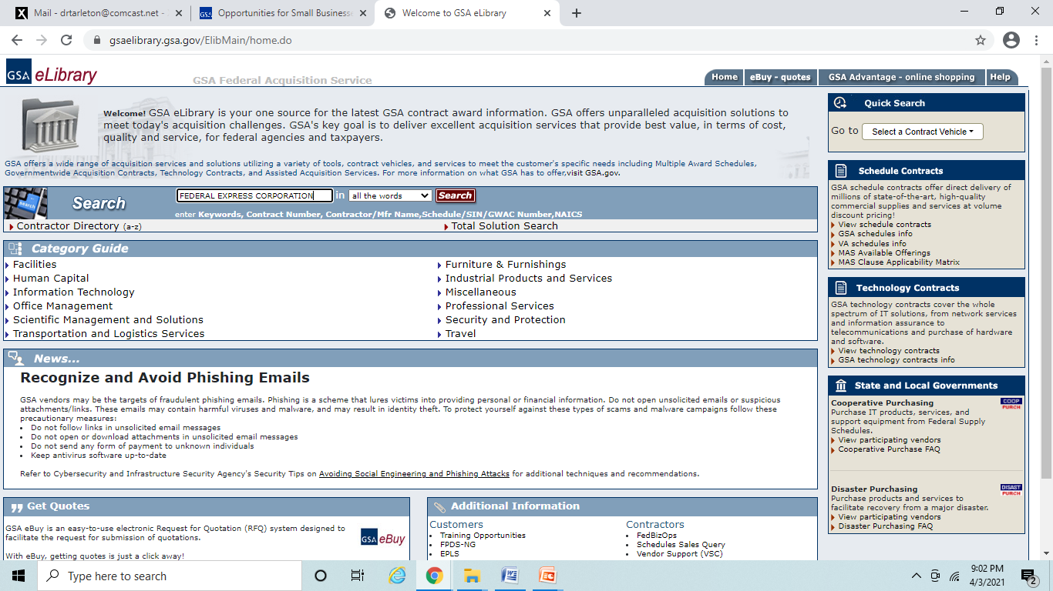
GSA eLibrary
GSA eLibrary is the official online source for complete GSA and VA Schedules information including awards. It provides a centralized source for researching Schedules that include basic ordering guidelines, complete Schedule listings and a powerful search engine. Small Businesses can use this as a tool to locate contractors for potential teaming arrangements and/or subcontracting opportunities. Website: http://www.gsaelibrary.gsa.gov

Slide 20
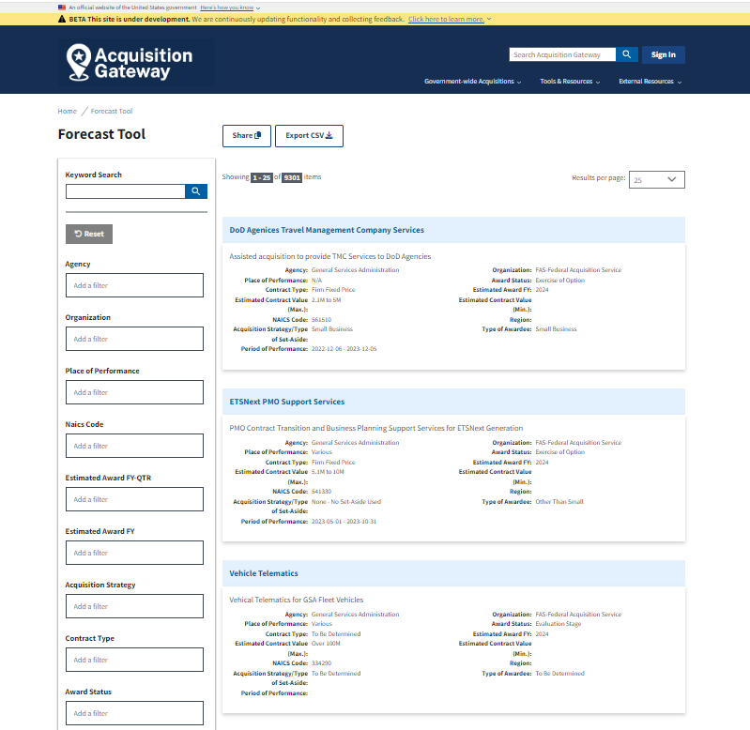
GSA’s Forecast of
Contracting Opportunities
Forecast of Contracting Opportunities
Download to MS Excel
Keyword Search
Search Results
Filter Options
www.acquisitiongateway.gov/forecast

Slide 21
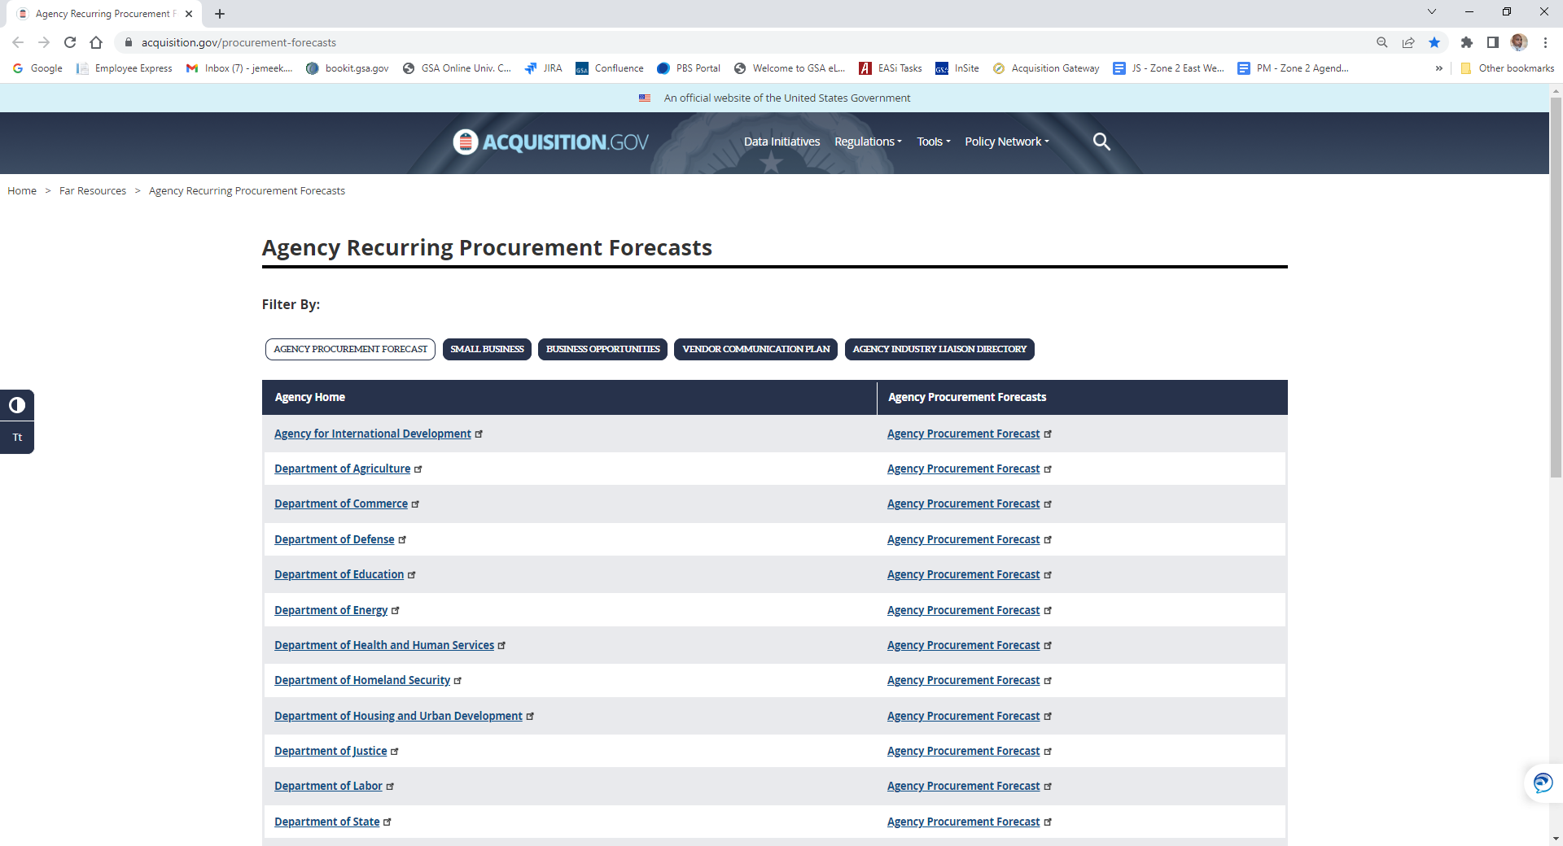
Forecast of Opportunities
With Other Federal Agencies
https://www.acquisition.gov/procurement-forecasts

Slide 22
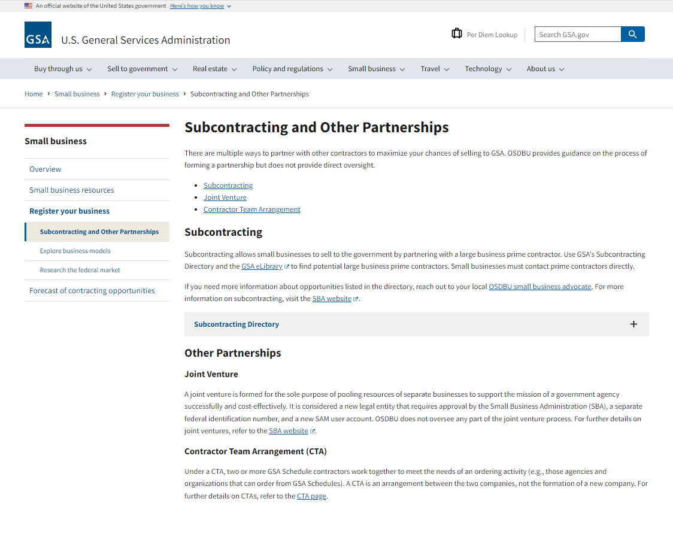
Subcontracting Opportunities
Subcontracting Criteria:
GSA’s Subcontracting Directory:
Subcontracting provides additional opportunities to obtain experience if you are not yet a Federal contractor.
Other-than-small businesses are required to submit a subcontracting plan for approval when:
  The total value of the award is expected to exceed $750,000 (or $1.5 million for construction) and
  Subcontracting opportunities exist.
  Plans must demonstrate “Maximum Practicable Opportunities” for small business concerns to participate
For more details visit: https://www.gsa.gov/subcontracting

Slide 23
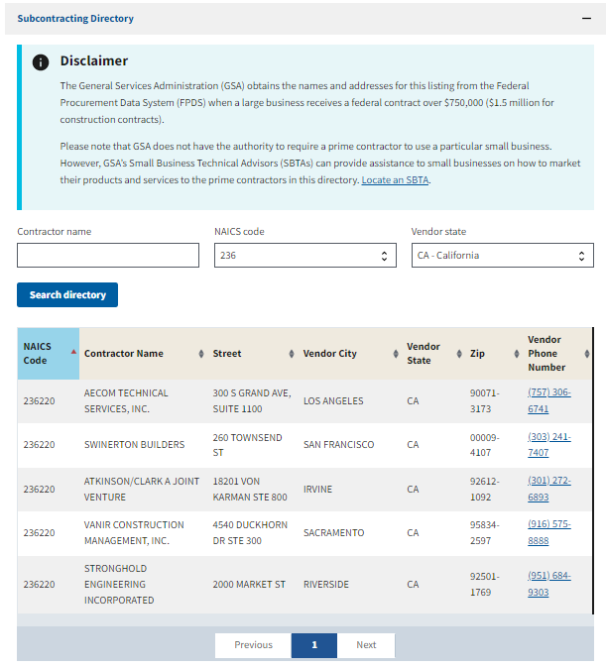
GSA SUBCONTRACTING (NATIONWIDE)
When a large business receives a
federal contract over $750,000
($1.5 million for construction contracts)
Utilize GSA's Subcontracting Directory and GSA’s eLibrary to find potential large prime business contractors.
Small businesses must contact
prime contractors directly
www.gsa.gov/subdirectory.gov

Slide 24
GSA eTool Sites:
System for Award Management (SAM) - https://sam.gov/content/home
Federal Procurement Data System (FPDS) - https://www.fpds.gov/fpdsng_cms/index.php/en/
USA Spending.gov - http://www.usaspending.gov
GSA e-Buy - http://www.gsa.gov/ebuy
GSA eLibrary – http://www.gsaelibrary.gsa.gov
Forecast of Contracting Opportunities Tool – https://www.acquisitiongateway.gov/forecast
Forecasting Tool Factsheet & Video: https://www.gsa.gov/small-business/forecast-of-contracting-opportunities?topnav=small-business
Federal Agency Procurement Forecasts - https://www.acquisition.gov/procurement-forecasts

Slide 25
Additional GSA OSDBU Information
  www.gsa.gov/small-business
  www.gsa.gov/small-business/small-business-resources
  www.gsa.gov/osdbufactsheets
  www.gsa.gov/osdbuevents specific to the OSDBU hosted events
  https://www.gsa.gov/events GSA wide agency events
Small Business | GSA

Slide 26





Additional Resources
www.sba.gov
https://www.apexaccelerators.us/#/
www.gsa.gov/events
https://www.gsa.gov/small-business/small-business-resources
www.mbda.gov
https://www.aptac-us.org/

Slide 27
Questions???
Jemeek Morris
Procurement Analyst / Small Business Technical Advisor
Email: Jemeek.Morris@gsa.gov
Phone: 917-969-7963
For More Information

Slide 28
Survey
Your feedback is valuable to us. Please take a moment to share your thoughts by completing a brief survey. Your input helps us improve and tailor our future sessions. Thank you in advance for your time!
SURVEY LINK:
https://feedback.gsa.gov/jfe/form/SV_77XKEDn6qb6RKMS

