Slide 1

GSA’s Forecast Tool of Contracting
Opportunities
Claudia Hadley and Robin Reyes
Small Business Specialists
Office of Small and Disadvantaged Business Utilization (OSDBU)
May 3, 2024
U.S. General Services Administration

Slide 2

Today’s Agenda
GSA OSDBU Overview
Where is the OSDBU Located
Importance of Market Research
Forecast of Contracting Opportunities
  What it is
  Benefits
Accessing and searching the Forecast Tool
Using Forecast data
Best practices
Resources
Questions and Answers (Q&A)

Slide 3
About OSDBU
According to the Small Business Act as amended by Public Law 95-507, the Office of Small and Disadvantaged Business (OSDBU) was established to:
Advocate, within each Federal Executive Agency, for the maximum practicable use of all designated small business categories within the Federal Acquisition process.
Ensure inclusion of small businesses as sources for goods and services in Federal acquisitions as prime contractors and subcontractors.
Manage the small business utilization programs for OUR respective organization.
https:www.gsa.gov/smallbusiness

Slide 4
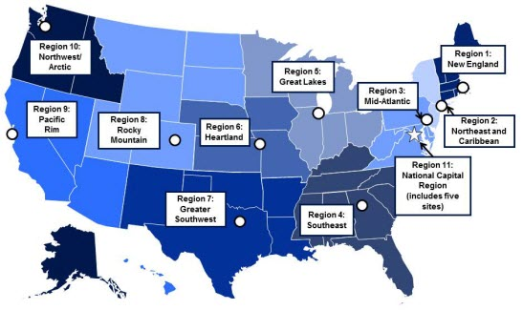
GSA OSDBU
GSA’S Regional Offices
Region 1: Boston, MA
Region 2: New York, NY
Region 3: Philadelphia, PA
Region 4: Atlanta, GA
Region 5: Chicago, IL
Region 6: Kansas City, MO
Region 7: Ft. Worth, TX
Region 8: Denver, CO
Region 9: San Francisco, CA
Region 10: Auburn, WA
Region 11: Washington, DC
https://www.gsa.gov/about-us/contact-us/small-business-support

Slide 5
Research the Federal Market
E-Tools
GSA Forecast Tool – Learn about potential prime contracting opportunities
https://acquisitiongateway.gov/forecast
Federal Agency Procurement Forecasts – Learn about potential prime contracting opportunities -- https://www.acquisition.gov/procurement-forecasts
GSA eLibrary - the official online source for complete GSA and VA Schedules information including awards. Small Businesses can utilize this tool to locate contractors for potential teaming arrangements and/or subcontracting opportunities. --https://www.gsaelibrary.gsa.gov/ElibMain/home.dois
GSA Subcontracting Directory – Conducting Market Research and a Competitive Analysis affords your business a competitive edge. -- https://www.gsa.gov/small-business/register-your-business/subcontracting-and-other-partnerships#Subcontracting
SBA Dynamic Small Business Search (DSBS) –The Dynamic Small Business Search (DSBS) database is maintained by the SBA. Contracting Officers and prime contractors use this tool to identify potential small business contractors for upcoming potential prime contracting and subcontracting opportunities.

Slide 6









Importance of Market Research
Steps to Developing Leads in the Federal Market
What contracts are set to expire that I can compete for in the future?
Who are my competitors? Who holds the current contract?
How much are they buying?
Have they
awarded any set-asides?
Which Federal Agencies are purchasing my product or service
The Unknown can cause Frustration and Disappointment

Slide 7

DATA
Let the Data Refine You Overall Strategy!
Use Data to Develop a Targeted Strategy
Know which Agency Forecast Tools to Use
Develop leads, short and long term goals
Become More Efficient

Slide 8
Did you know?
The forecast of contracting opportunities is a list of expected Federal contracts.
Public Law (Pub. L.) 100-656, the Business Opportunity Development Reform Act of 1988, requires agencies to prepare a forecast.
The Forecast Tool is an automated solution to provide forecast information to the public.

Slide 9
Forecast Benefits
Early awareness of anticipated opportunities
User-friendly search, filter, and export data functions
One-stop shop for Federal agency forecasts
  General Services Administration
  Department of the Interior
  Department of Labor
  Small Business Administration
  Office of Personnel Management
  Department of Veterans Affairs

Slide 10
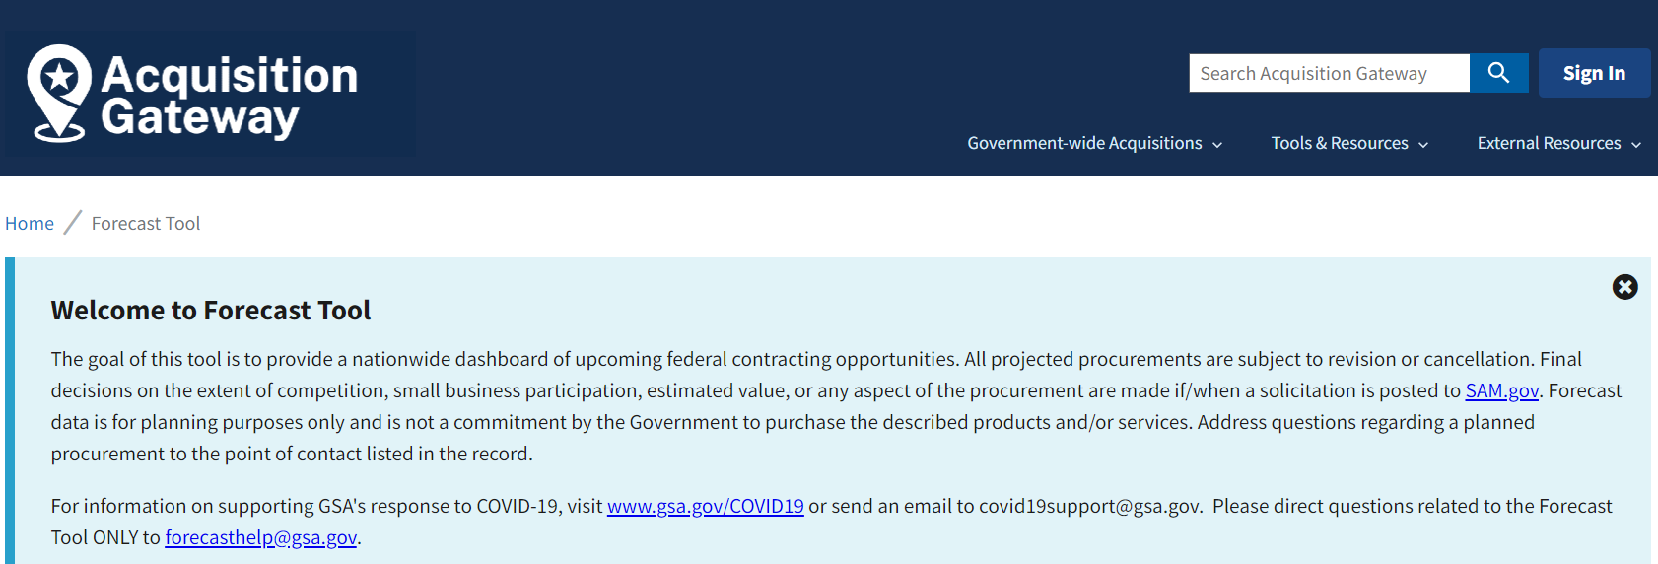
How to Access the Forecast Tool
https://www.acquisitiongateway.gov/forecast
No username or password required

Slide 11
Search Options
Filters
  Agency; Place of Performance (State); NAICS Code; Estimated Award Quarter/Fiscal Year; Acquisition Strategy/Type of Set-Aside; Contract Type; Award Status
Keyword Search
Combined filters/keyword search
Export to *.csv

Slide 12
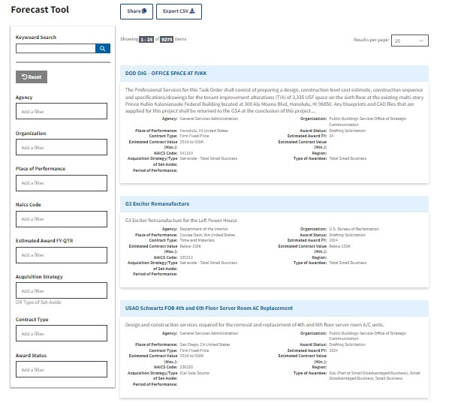
GSA Forecast of Contracting Opportunities
How to Access the Forecast Tool:
Background:
Download to Excel and Share
Focuses on acquisition planning and increases awareness of potential prime and subcontracting opportunities.
The goal is to help both GSA buyers and vendors easily communicate around potential contracting opportunities.
The tool includes information for GSA, Department of Interior, Department of Labor, U.S. Small Business Administration, U.S. Office of Personnel Management, , and U.S. Department of Veterans Affairs
Forecast Website Access:
  https://acquisitiongateway.gov/forecast
  https://www.fbf.gov
  https://www.acquisition.gov/procurement-forecasts
Search by NAICS Code
Filter Options
Click Description Title to View Details

Slide 13
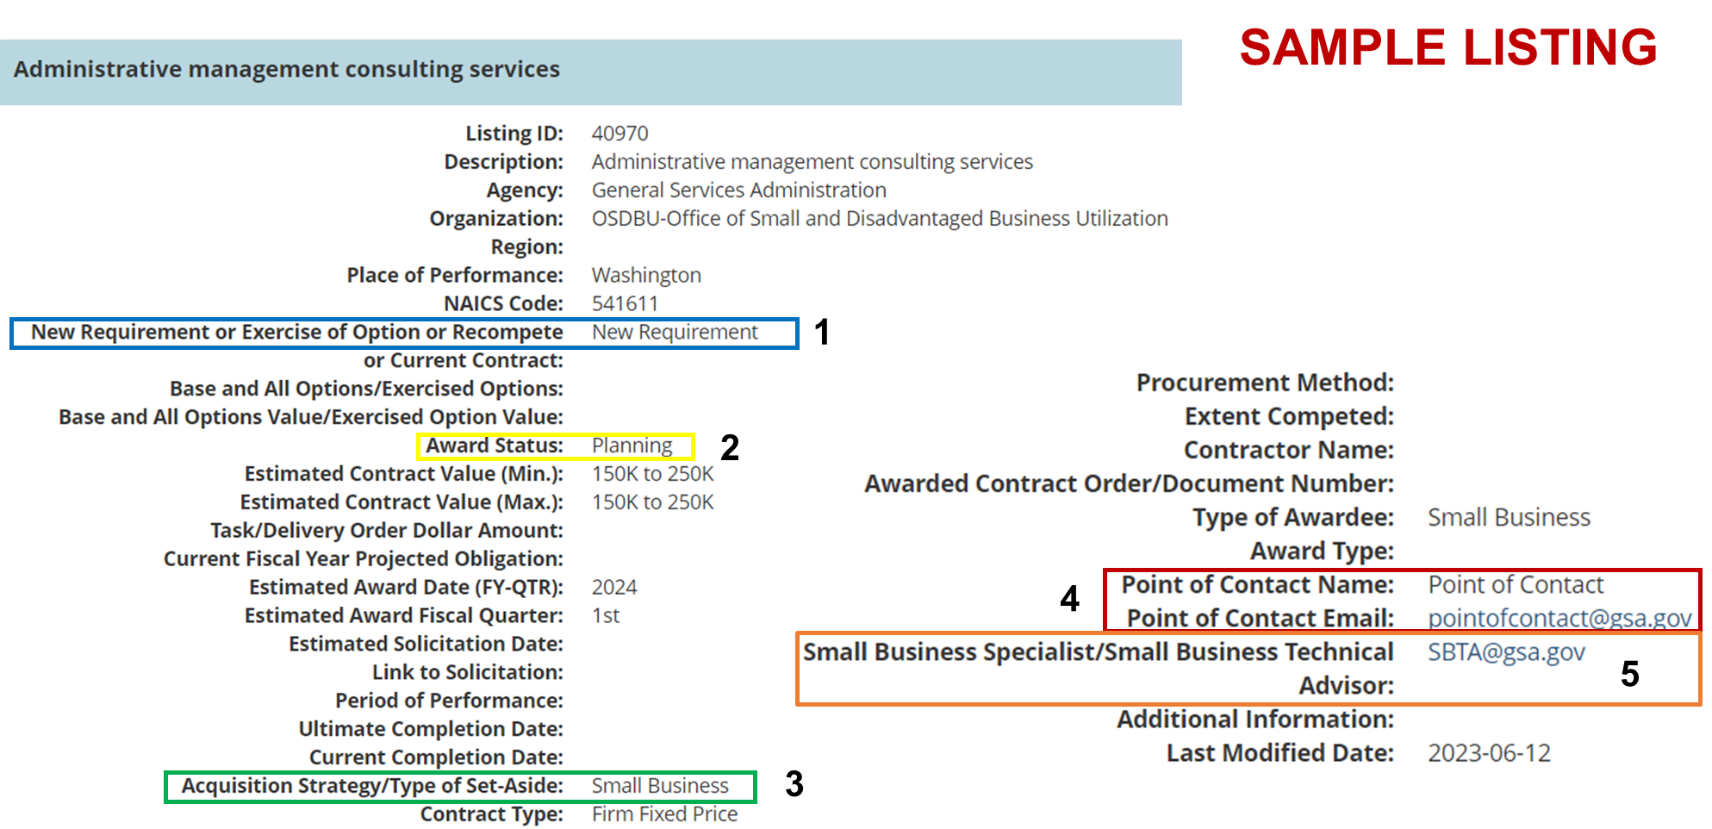
Leverage Forecast Listing Data

Slide 14
BEST PRACTICES
Know your NAICS code(s)
  www.census.gov/naics/
Check Forecast Tool weekly
Get to know agency OSDBU representatives

Slide 15
Resources
Factsheet: Use the GSA Forecast Tool to Find Contracting Opportunities
  www.gsa.gov/osdbufactsheets
Agency Recurring Procurement Forecasts
  www.acquisition.gov/procurement-forecasts

Slide 16
Websites:
GSA Forecast of Contracting Opportunities Tool – www.gsa.gov/smbusforecast
Federal Agency Procurement Forecasts - https://www.acquisition.gov/procurement-forecasts
GSA eLibrary – http://www.gsaelibrary.gsa.gov
GSA Advantage - https://www.gsaadvantage.gov
GSA e-Buy - http://www.gsa.gov/ebuy
Federal Procurement Data System (FPDS) - https://www.fpds.gov
Small Business Goaling Reports - https://sam.gov/reports/awards/static
USA Spending.gov - http://www.usaspending.gov
Federal Service Desk (FSD) - http://www.fsd.gov
SBA Dynamic Small Business Search (DSBS) - https://web.sba.gov/pro-net/search/dsp_dsbs.cfm

Slide 17
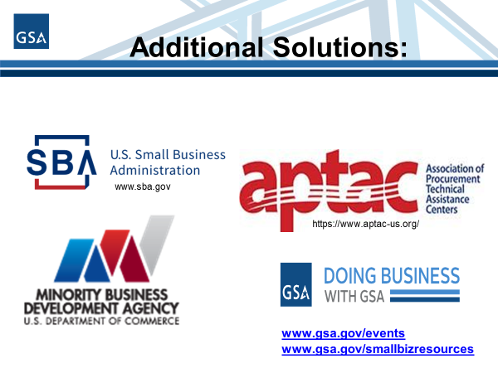
Additional Solutions

Slide 18
Have questions or need more information?
GSA OSDBU Small Business Specialists: www.gsa.gov/smallbizsupport
forecasthelp@gsa.gov

Slide 19
QUESTIONS ?

Slide 20
Survey
Your feedback is valuable to us. Please take a moment to share your thoughts by completing a brief survey. Your input helps us improve and tailor our future sessions. Thank you in advance for your time!
SURVEY LINK:
https://feedback.gsa.gov/jfe/form/SV_88hPv1XEhfeiBFQ

