Slide 1
Emergency Acquisition Basic Ordering Agreements
Office of Acquisition Operations (QMA)
presented by
Reagan Criddle

Slide 2
Introduction
Who we are
QMA falls under GSA’s Federal Acquisition Service (FAS).
FAS’s mission is to provide an exceptional customer experience by delivering best value goods and services through an increasingly digital environment.
Who we support
Primarily we support other Federal agencies; however, GSA allows other non-federal government entities to utilize its contracting vehicles and sources of supply under certain circumstances.

Slide 3
Agenda
Explain what BOAs are, how they work, and who can use them
Discuss the Emergency Acquisition (EA) Basic Ordering Agreements (BOAs)
Review the scope of the EA BOAs along with the benefits of using them
Discuss the Ordering Process and Example Requirements
Summary & Data
Q&A

Slide 4
Basic Ordering Agreements
Federal Acquisition Regulations (FAR) 16.703
BOAs are written instruments of understanding, negotiated between an agency, contracting activity, or contracting office and a contractor, that contains (1) terms and clauses applying to future contracts (orders) between the parties during its term, (2) a description, as specific as practicable, of supplies or services to be provided, and (3) methods for pricing, issuing, and delivering future orders under the basic ordering agreement. A basic ordering agreement is not a contract.
BOAs are effective instruments for expediting contracting activities for uncertain requirements in which specific quantities, items, and prices are not known at the time of execution of the agreement.

Slide 5
QMA’s EA Basic Ordering Agreements
BOAs were initially considered to assist QMA with rapidly procuring supplies and services in support of FEMA. During Acquisition Planning and market research, it became clear these vehicles could also offer value to other Federal agencies in times of emergency.
These BOAs may be used, free of charge, by all Federal agencies.
QMA executed 19 BOAs with vendors from diverse industries and locations to ensure FEMA and other Federal agencies would have a pool of experienced and capable vendors to procure commercial supplies and services from in times of emergency.
Of the 19 BOAs executed, 15 of the vendors are Small Businesses.

Slide 6
Scope
QMA’s EA BOAs may be used to rapidly procure just about any commercial supply or service, so long as the requirement is in support of an emergency.
QMA’s definition of emergency is broader than that found in the FAR which requires a Presidential declaration.
If a given requirement is determined an emergency by an agency, or a Presidential declaration is made, your requirement for commercial supplies or services is likely within the scope of this BOA.
Should there be questions about scope or use of these BOAs, contact the EA BOA Contracting Officer (see Contacts slide).
Notes:
The term “Emergency” used within this agreement means events which meet the definition found in FAR 2.101 OR any situation which, if not corrected immediately, will result in unnecessary expenditure of funds, property damage, personal injury, or interruption of agency functions.

Slide 7
Benefits
Easy to use
Flexible to unique situations and buyers
Competitive without sacrificing quality or time
No price lists or item catalogs
Rapid Response & Delivery Timeframes

Slide 8
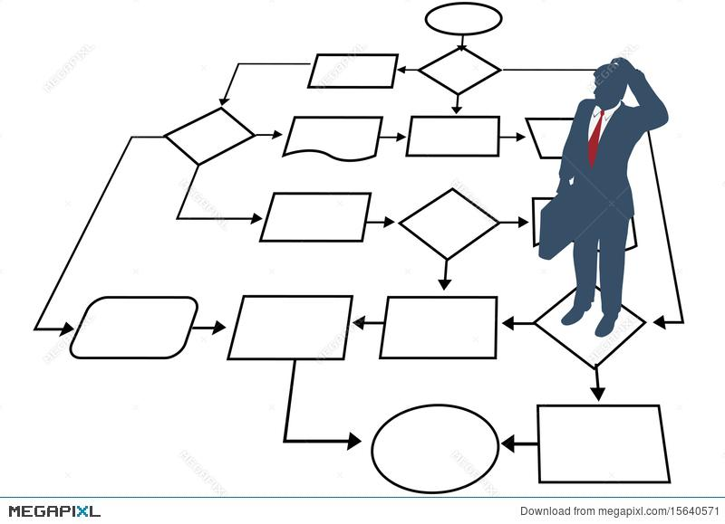
Typical Acquisition
Process Flow
Identification of need
Describe/Define requirement
Market Research & Acquisition Planning
Review & Approval
Draft solicitation
Review & Approval
Publish/distribute solicitation
Evaluate quotes/offers
Draft award decision
Review & Approval
Send order/contract to awardee for signature
CO countersigns award document
Distribute award to awardee
Publish award notice

Slide 9
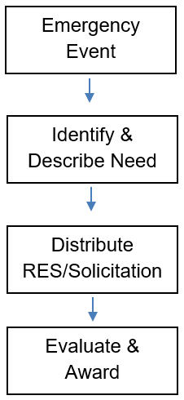
EA BOA Process Flow
QMA has already performed the market research, acquisition planning, and responsibility determinations to streamline ordering procedures for users.
The BOA was synopsized through SAM.gov and provided fair opportunity.
Authorized users may jump right into their solicitations after they have identified their emergency requirement and adequately described their need.
Rapid response times, evaluation procedures, and delivery terms are present in the BOA allowing streamlined competition and awards.

Slide 10
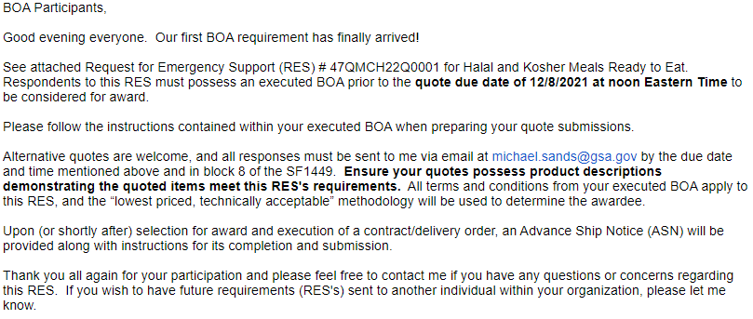
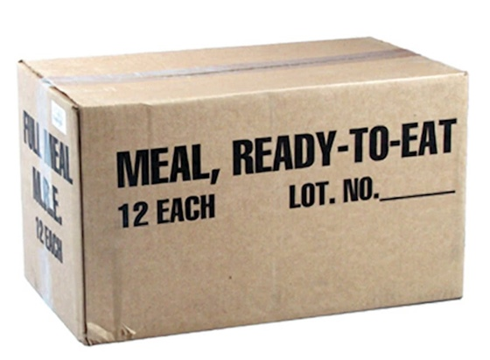
Example Requirement

Slide 11
Summary & Data
QMA’s EA BOAs offer a streamlined approach to commercial purchases during emergencies.
Any Federal agency can use, free of charge.
No price lists or item catalogs
The EA BOAs have been used to rapidly purchase meals, COVID test kits, sheltering items, Joint Field Office (JFO) kits, and pandemic kits.
Average savings of ~33% in FY24, ~39% in FY23, and ~32% in FY22
Competitive process - competitive quotes received on all solicitations

Slide 12
References & Contacts
https://www.acquisition.gov/far/part-16#FAR_16_703
A copy of the BOA and Master Contact List of BOA Participants may be found at the link below:
https://www.gsa.gov/governmentwide-initiatives/emergency-response/emergency-acquisition-basic-ordering-agreements
QMA EA Contracting Officers:
Reagan Criddle, 312-208-4834, reagan.criddle@gsa.gov

